Slide 1
KAUST Bioinformatics Summer School
Week 4 mini-presentations
Metagenomics

Slide 2
How to prepare your slide
Slide title: the question that you wanted to answer.
Include one figure from your analysis.
Add a few sentences to the slide:
(1-2 sentences) What did you do to answer the question, i.e. what analysis you ran.
(1-2 sentences) Your results/conclusions, which directly answers the question in the slide.
Add a new slide to this presentation with your name and question

Slide 3
Was anything actually lost?
Duvallet et al. (2017) Meta-analysis of gut microbiome studies identifies disease-specific and shared responses
“By collapsing the data to genus level, we lost the sensitivity to detect fine-scale differences in species or strain abundances across case and control groups, but we minimized certain batch effects that plague comparisons across studies.”
My test case: crc_baxter, 120 Colorectal cancer and 172 Controls.
Hanyn A. Alturki

Slide 4
Was anything actually lost?
What I did
Started with the ready-made bacteria count table from MicrobiomeHD.
Turned counts into % of each sample, and dropped bacteria with no genus name.
Analysed it at two zoom levels: grouped by genus vs. left as individual OTUs.
At each level, ran two things: a per-genus test for differences (Kruskal–Wallis + FDR) and a whole-community map (PCoA).
Compared which bacteria each zoom level and each method actually found.
 | Genus | OTU
Features tested | 101 | 945
Significant (q < 0.05) | 18 | 5
CRC pathogens recovered | 4 / 4 | 2 / 4
Finer resolution tested ~9× more features but found fewer hits, and recovered less known biology.
Hanyn A. Alturki
Notes:
First: Statistical Power. Having more features means the FDR (False Discovery Rate) correction imposes heavier penalties for multiple testing. So, a signal needs to be SUPER strong to be considered significant.
This explains why there are fewer hits at the species level, despite having a higher feature count.
Second: Signal Direction. Do signals move in the same direction? For this specific type of cancer, the literature suggests that disease-associated bacteria tend to be enriched.
This explains why genus-level aggregation succeeded here compared to the species level.
However, if the disease-associated bacteria were moving in opposing directions, I think the species level would yield more accurate results than the genus level………… a hypothesis I'll test in a future.

Slide 5
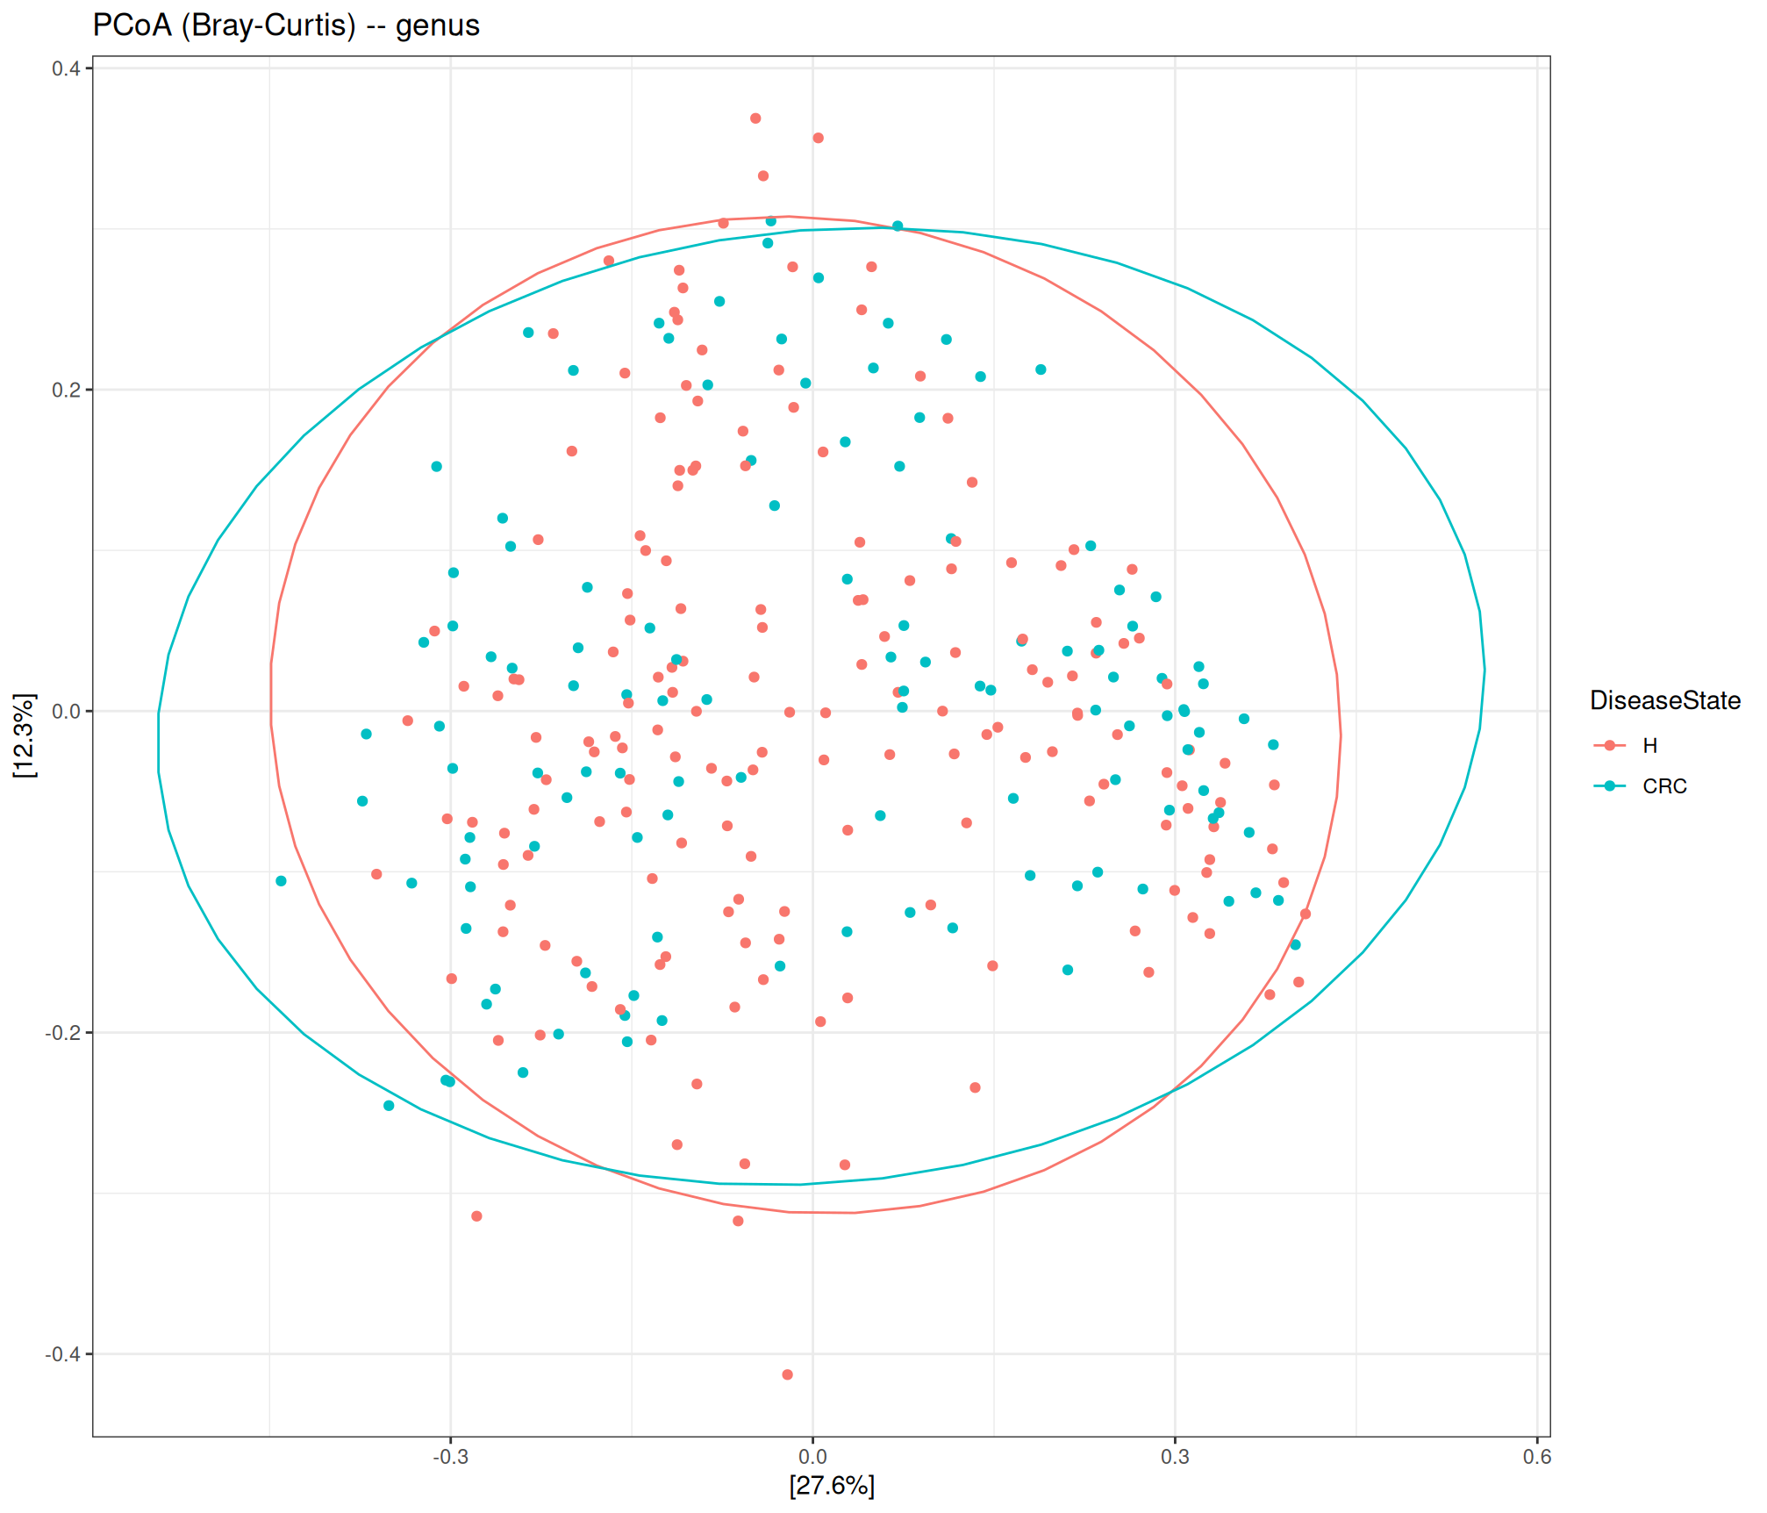
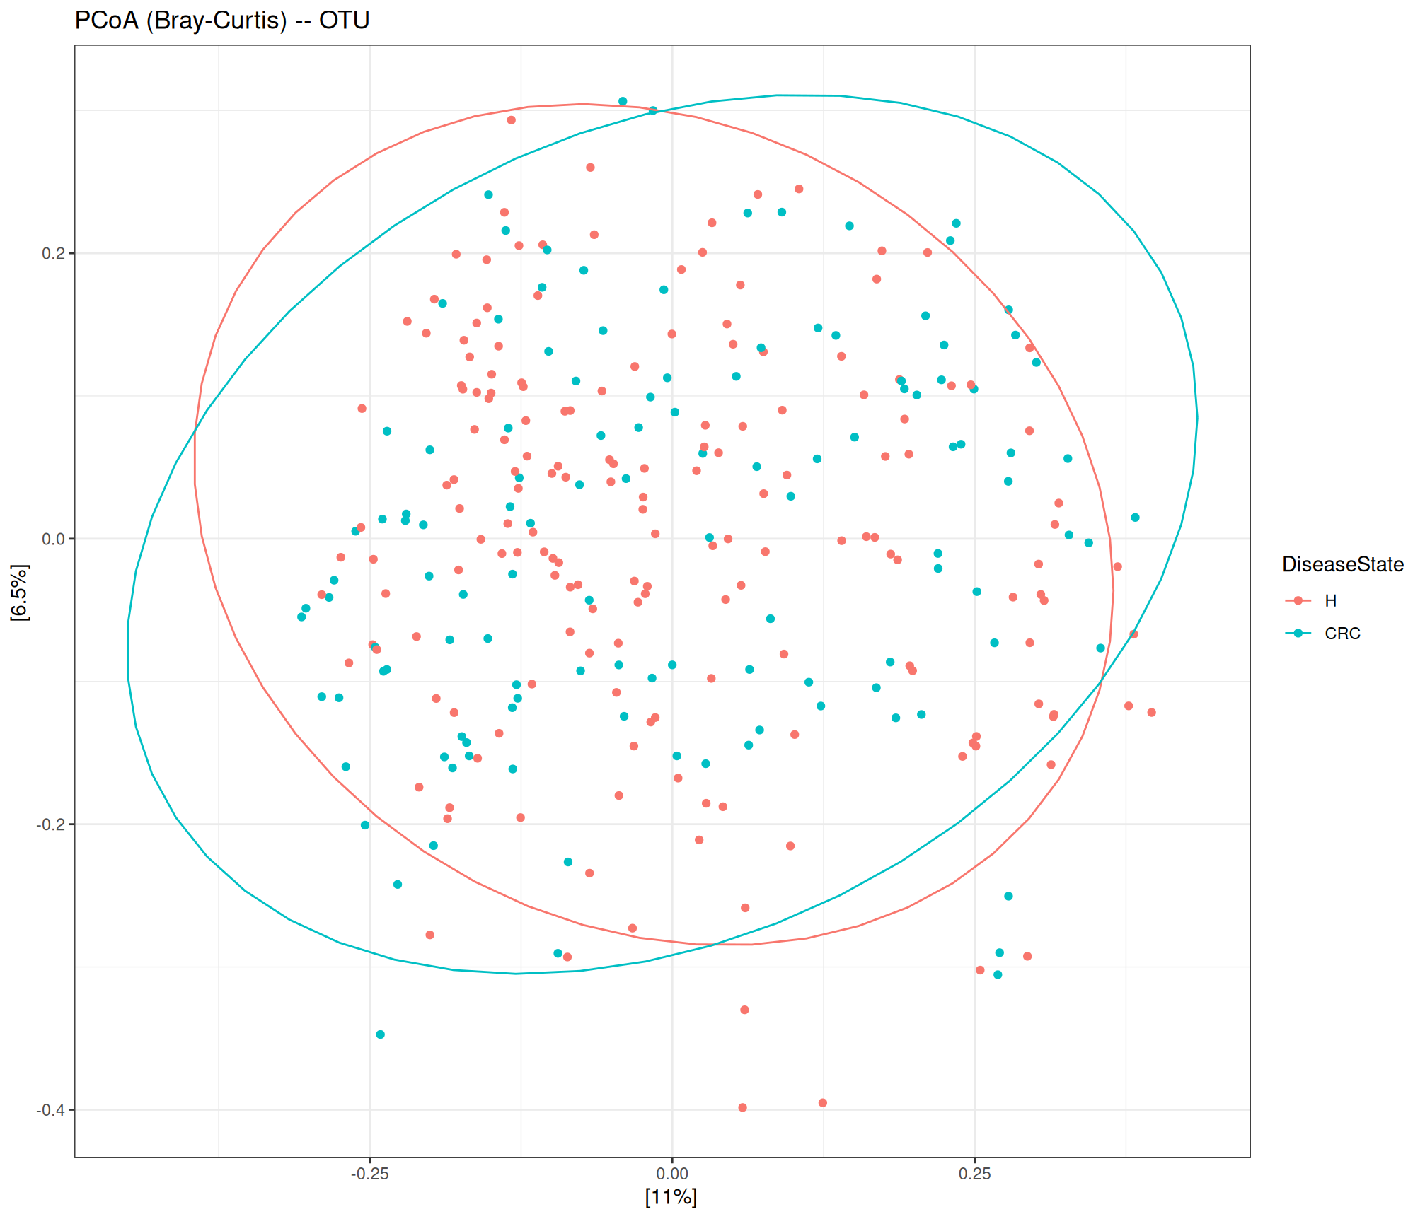
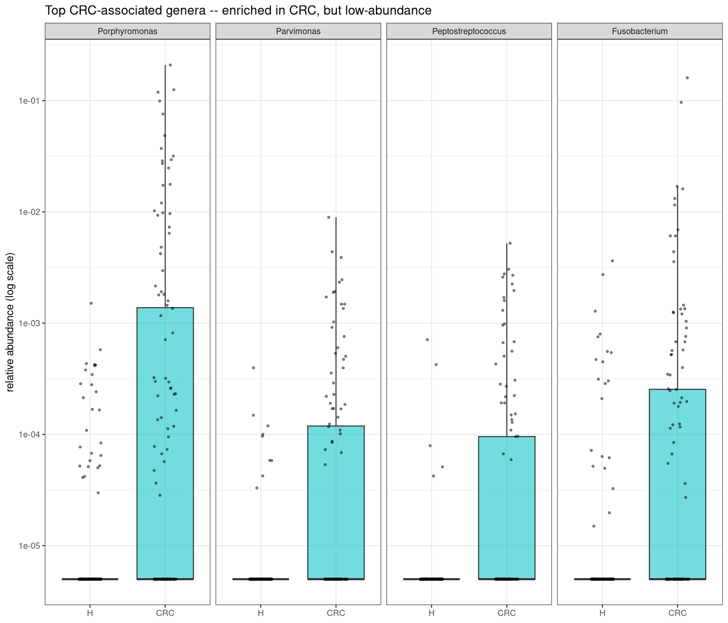
What about biology?
PCoA (Bray–Curtis), genus vs OTU. Each point = one participant; H and CRC overlap at both resolutions, no community-level separation.
Take away: Standardized re-analysis of one CRC cohort shows the disease signal is real but rare, carried by a few low-abundance pathogens.
Collapsing to genus wins when a rare signal all points one way, because grouping focuses the signal instead of averaging it out.
Box plot – Relative abundance (log scale), H vs CRC; each point = one sample. Shifted up in CRC in every panel, yet <1% abundance; absent in most healthy guts. All four significant (q < 0.05).
Hanyn A. Alturki

Slide 6
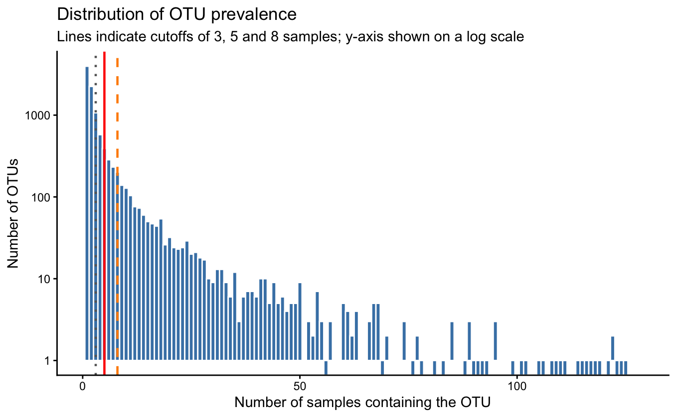
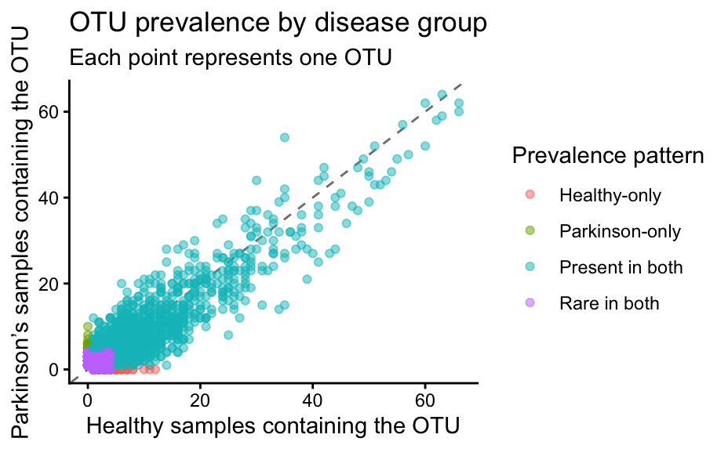
Gut microbiome composition in Parkinson’s Disease:
an amplicon-based 16S rRNA reanalysis
Scheperjans et al., 2014 explored the association of PD motor/ non-motor symptoms and the fecal microbiome.
Roche 454 pyrosequencing of 74 healthy and 74 PD patients; resulting in a processed V1–V3 16S OTU dataset.
Pre-proccesing + phyloseq object
Family-level comparison
Sparsity filtering + downstream QC
Bray-Curtis NMDS
Relative abundance
References
Sara Althaqafi
Notes:
The samples were sequenced using Roche 454 GS-FLX Titanium pyrosequencing targeting the V1-to-V3 region of the bacterial 16S ribosomal RNA gene.
The public reprocessed dataset contained 148 samples: 74 healthy controls and 74 Parkinson’s samples. The final cohort analysed in the original paper was slightly smaller, with 72 participants in each group.
Because the downloaded data were already processed into an OTU count table with RDP taxonomy, I did not repeat raw-read quality control or DADA2 processing. Instead, I combined the OTU abundance matrix, taxonomic assignments and sample metadata into a phyloseq object and started from the downstream section of the Cambio 16S workflow.
Taxonomy had already been assigned using RDP in the processed dataset. Because this was a downstream reanalysis and the main comparisons were performed at family level, I retained the supplied assignments rather than reclassifying the representative sequences using SILVA. SILVA would be appropriate for a modern raw-read reprocessing workflow, but changing reference databases could also change taxonomic labels and reduce comparability with the original processing.
I first assessed sample sequencing depth. The samples contained between 980 and 5,532 assigned counts, with a mean of approximately 2,805. Healthy samples had a slightly higher median depth than Parkinson’s samples—approximately 2,814 compared with 2,578—and this difference was statistically significant. I therefore used relative abundance for the downstream community analysis so that samples with more total counts did not automatically contribute larger abundance values.
The main challenge was OTU sparsity. The original table contained 10,232 OTUs, but most were detected in very few people. When I examined prevalence separately by disease group, 8,582 OTUs—approximately 84%—were detected in fewer than five samples in both groups.
I initially tried a 10% prevalence cutoff, requiring an OTU to occur in at least 15 of the 148 samples. However, this was too aggressive: it retained only 691 OTUs and 57.7% of the counts. I then tested a three-sample cutoff, which retained 4,026 OTUs and 84.4% of counts, but this appeared too lenient.
I therefore selected a global five-sample cutoff as a compromise. This retained 2,379 OTUs and 76.7% of the total counts. I also checked prevalence separately in the two disease groups. There were 32 OTUs detected in at least five healthy samples but absent from Parkinson’s samples, and 19 showing the reverse pattern. The global cutoff preserved these potentially group-specific features rather than removing them.
After filtering, I converted the count data to relative abundance and proceeded to Bray–Curtis ordination and family-level composition analysis.

Slide 7
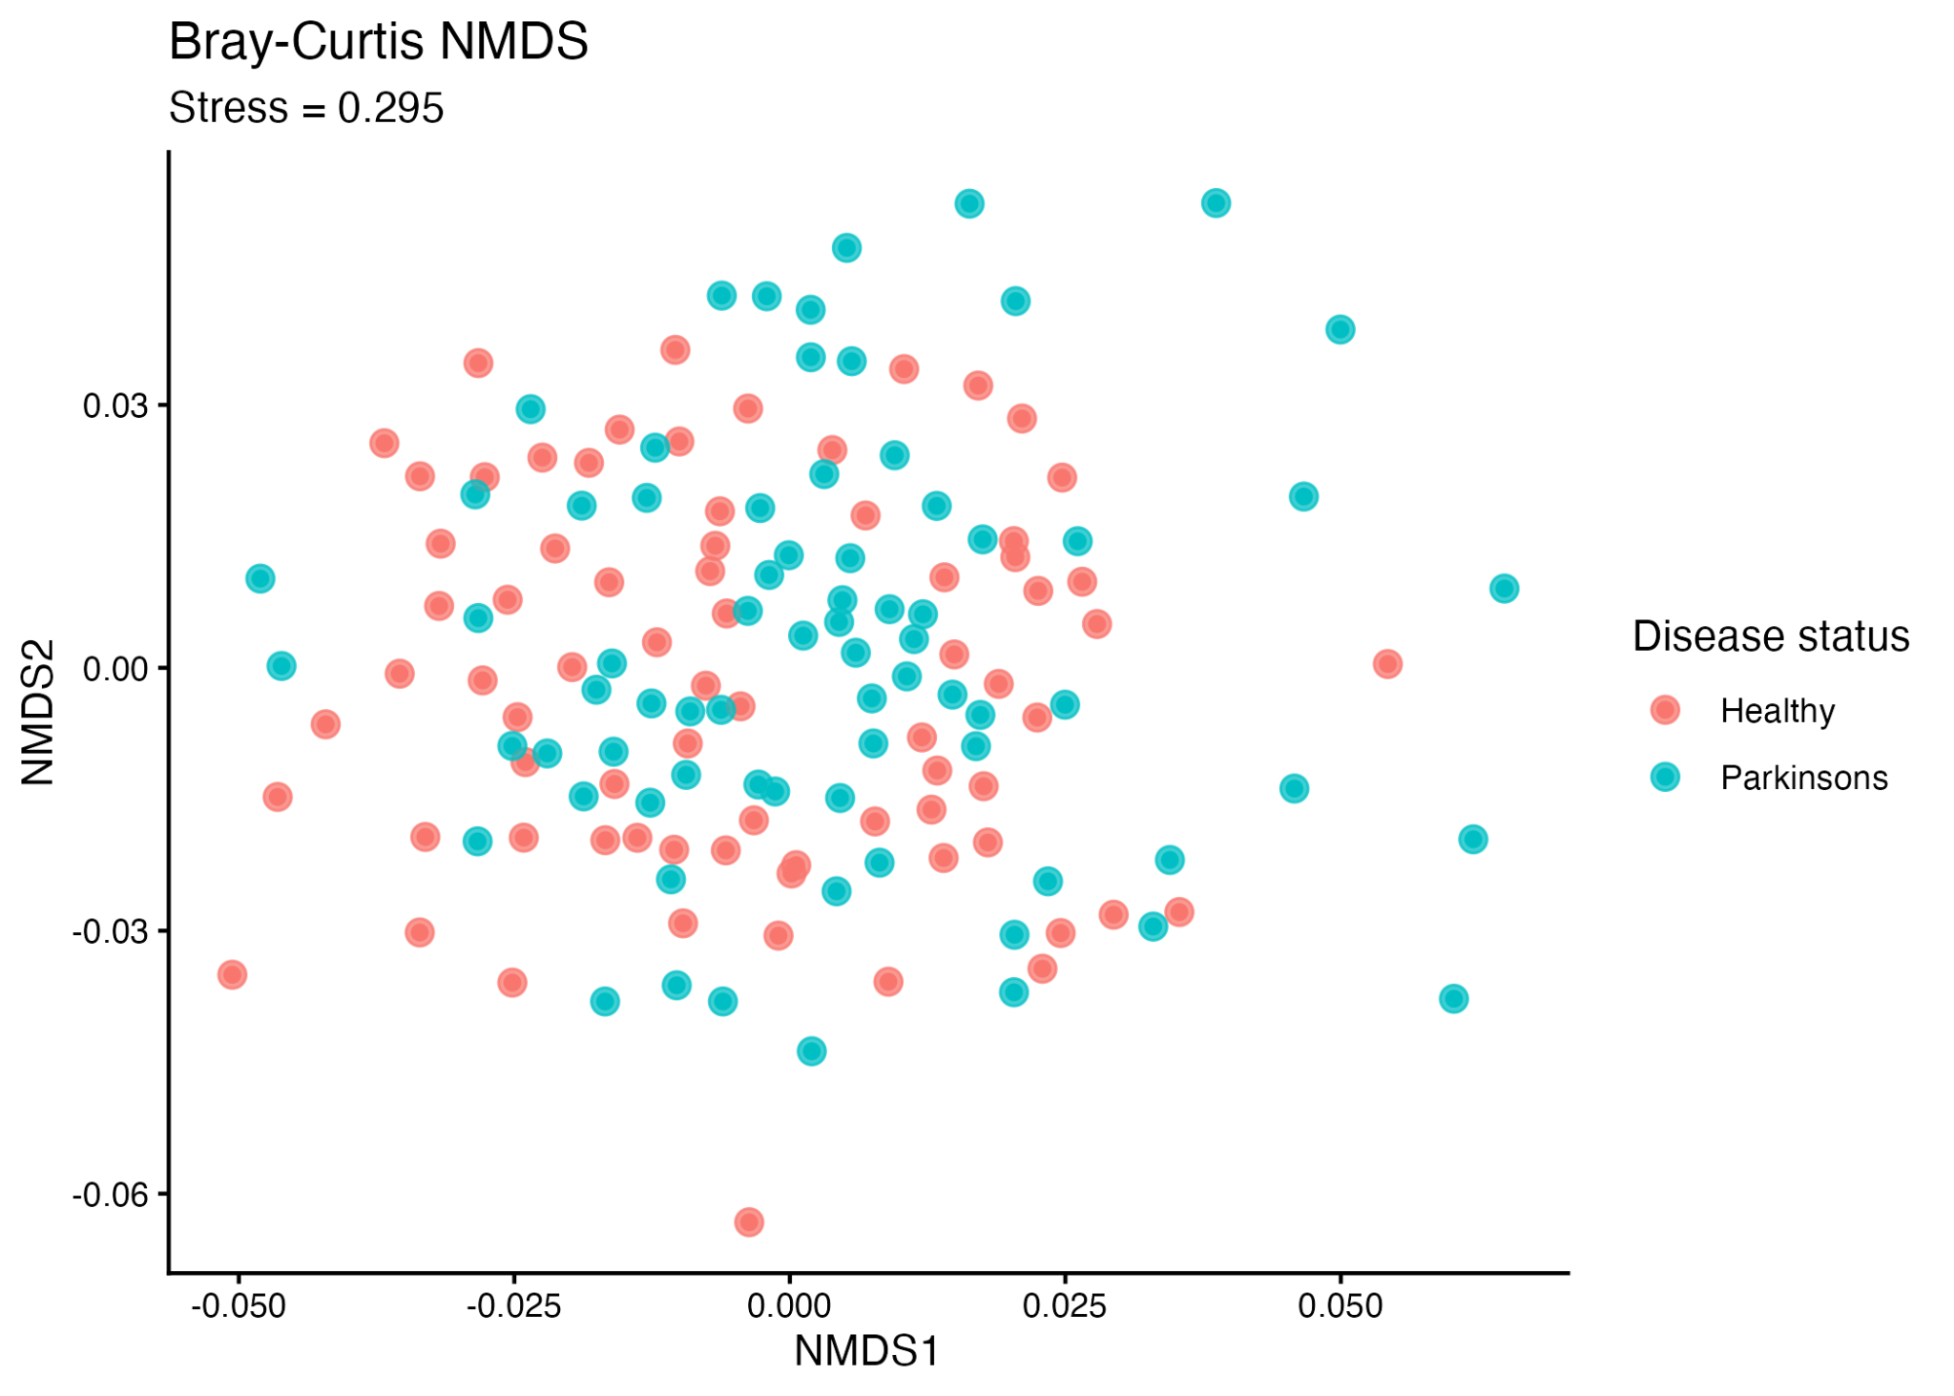
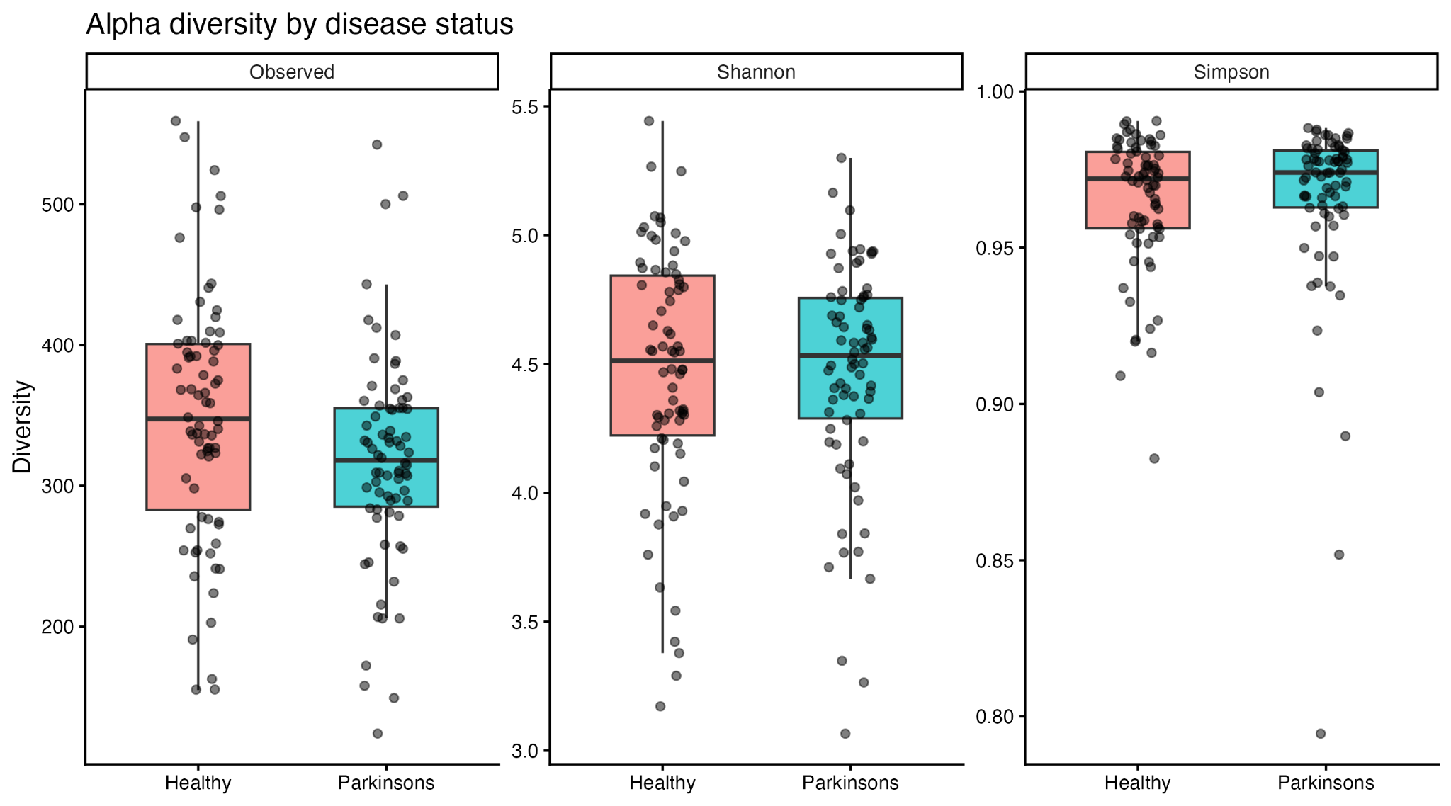
Gut microbiome composition in Parkinson’s Disease:
an amplicon-based 16S rRNA reanalysis
Poor separation and stress-value in 3 dimensions, better in 3 (0.21).
- two-dimensional
(4.4%)
(5.1%)
References
Sara Althaqafi
Notes:
I first calculated Bray–Curtis dissimilarities followed by two-dimensional NMDS.
In this plot, points that are closer together represent samples with more similar microbial compositions, while distant points represent more dissimilar communities.
The healthy and Parkinson’s samples overlap extensively, with no clear separation into two disease-specific clusters. The two-dimensional NMDS stress was 0.295, which is high and indicates that reducing the complex Bray–Curtis relationships to only two dimensions introduced substantial distortion.
To determine whether filtering caused the high stress, I repeated the analysis using the unfiltered OTU table. The stress was almost identical, showing that the filtering decision was not responsible. Increasing NMDS to three dimensions improved the stress to 0.21, although this still indicates some distortion.
I also generated a complementary Bray–Curtis PCoA. Its first two axes explained 5.1% and 4.4% of variation, respectively, and similarly showed substantial overlap between the groups. “Although the ordination showed extensive overlap, PERMANOVA detected a statistically significant difference between healthy and Parkinson’s microbiomes. However, disease status explained only around one percent of the total variation, so the effect was small and individual variation was much greater.
Therefore, the community-level conclusion is not that the microbiomes are identical. Rather, Parkinson’s disease status does not produce strong visual separation against the much larger background of interpersonal microbiome variation. The family-level stacked bars support this interpretation. There is considerable variation among individuals within both groups, and the dominant families are broadly shared. However, overall overlap does not rule out consistent differences in particular bacterial families, so I next performed family-level comparisons.
Alpha diversity describes diversity within each sample. Parkinson’s samples had lower observed richness, with a median of 318 OTUs compared with 347.5 in healthy controls. This was statistically significant after correction, with an FDR of approximately 0.029. However, sequencing depth was also lower in the Parkinson’s group, so this richness difference needs to be interpreted cautiously. Shannon and Simpson diversity were not significantly different, suggesting there was no strong difference in overall diversity or evenness.

Slide 8
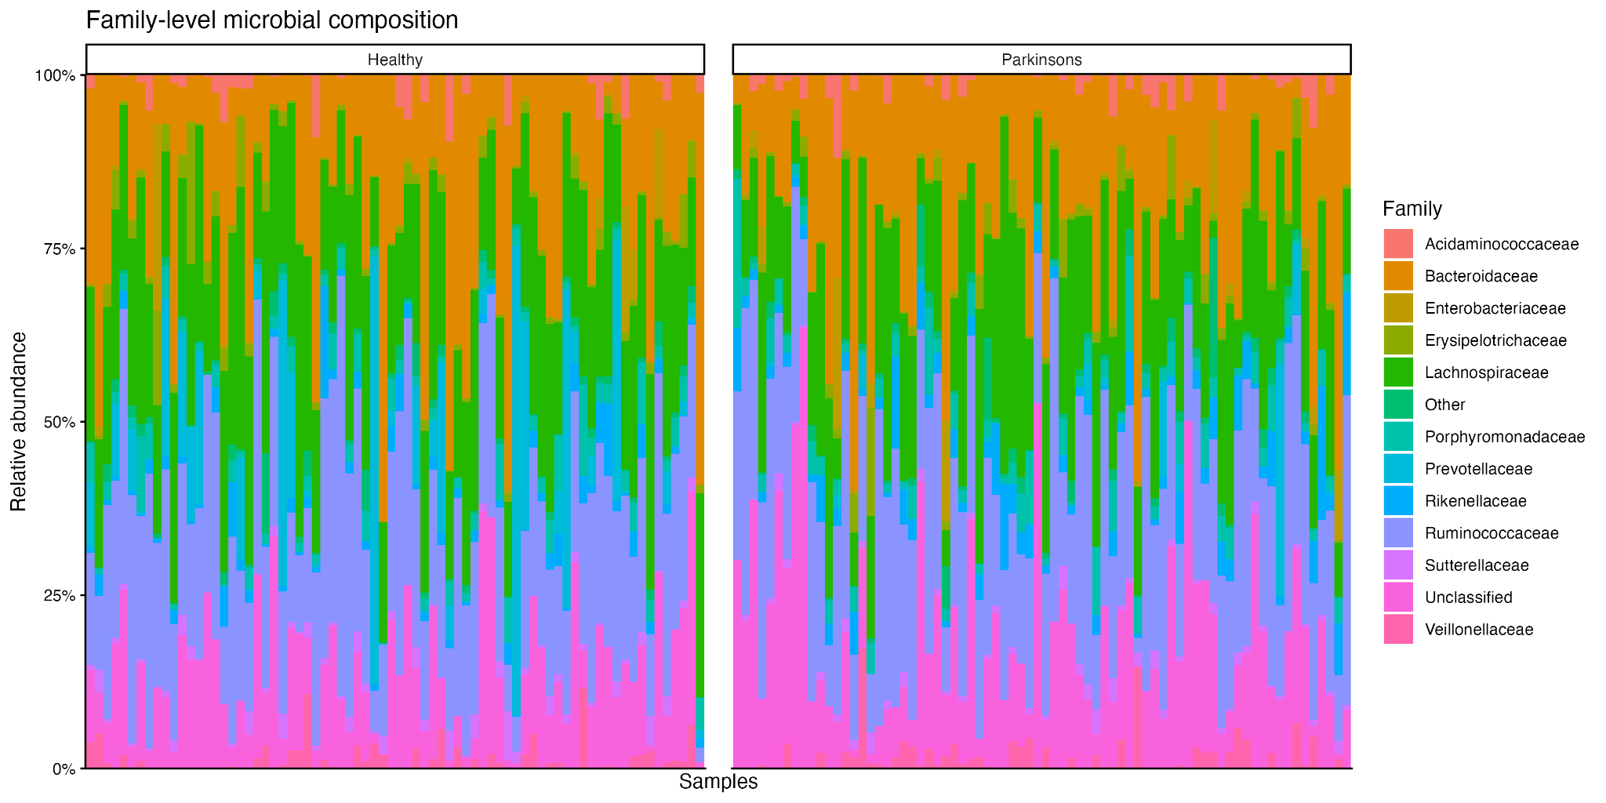
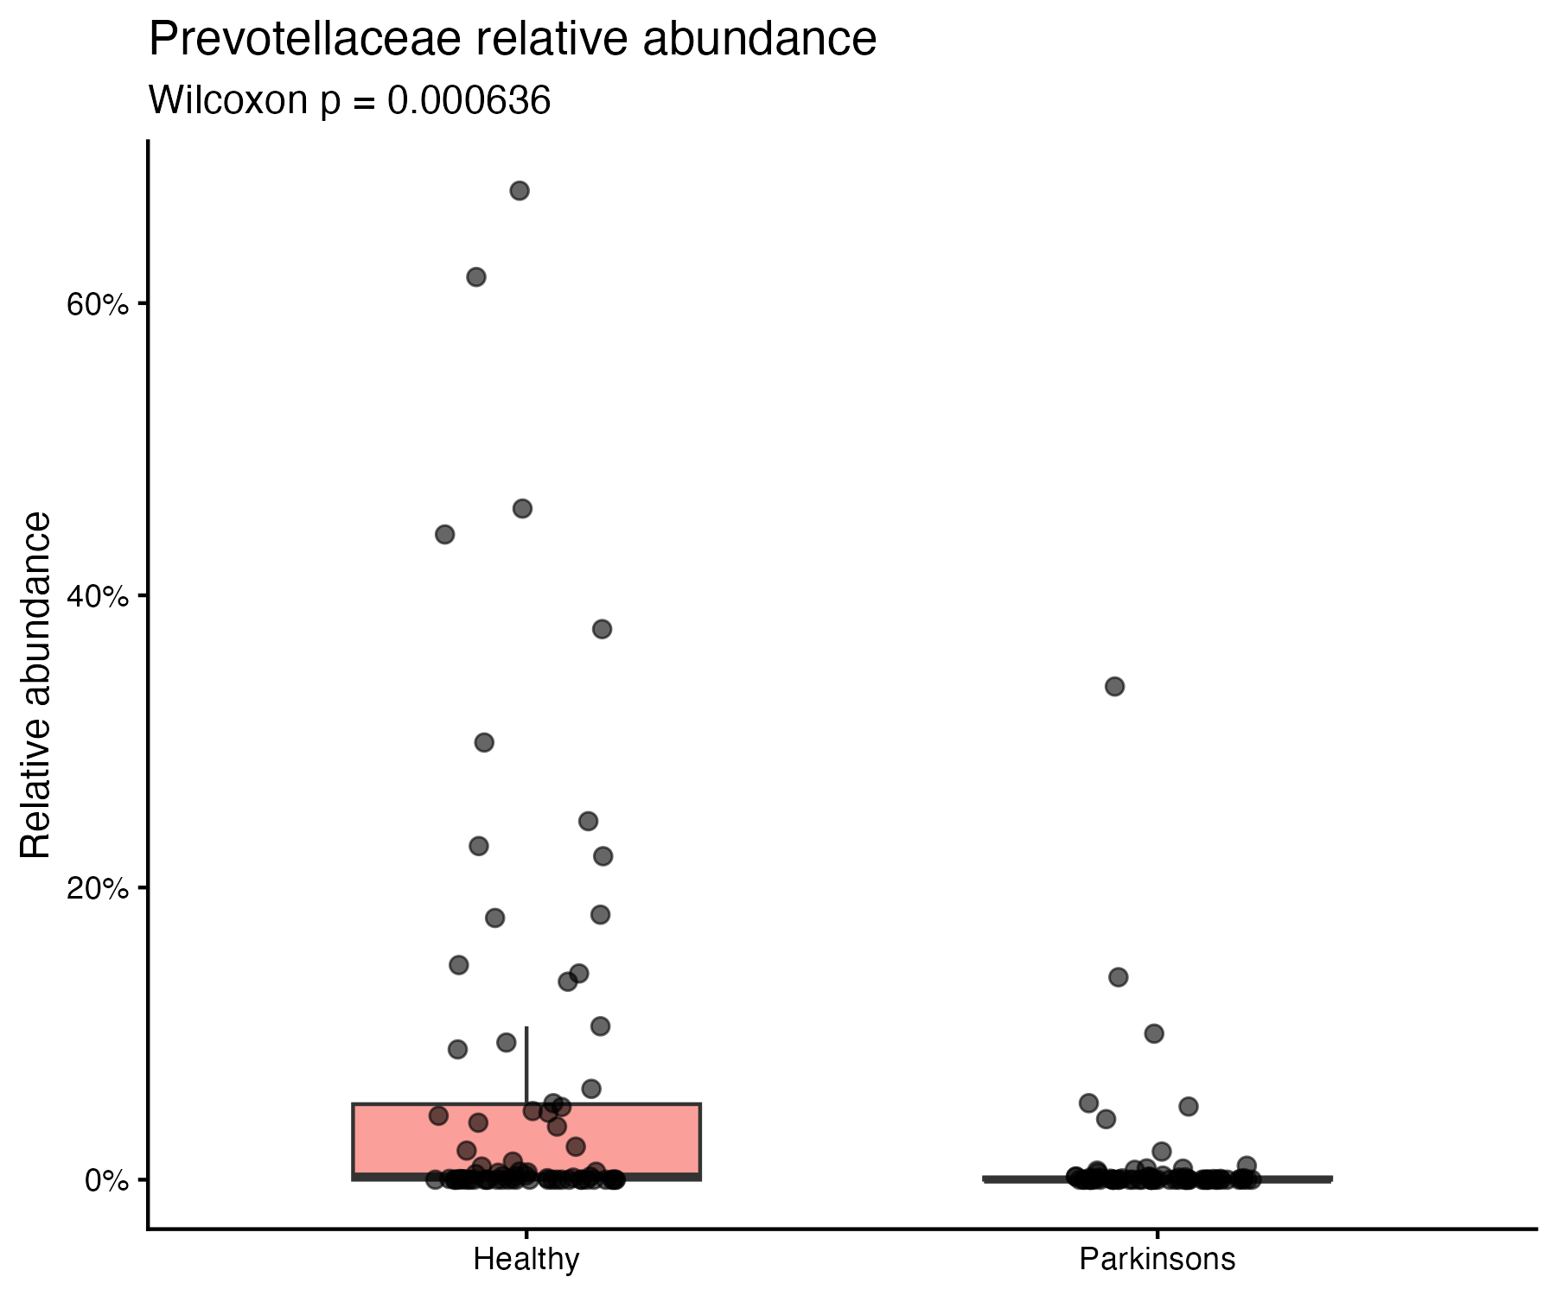
Prevotellaceae are 84% lower in Parkinson’s patients
Family | Direction | FDR
Rikenellaceae | Higher in Parkinson’s | 0.0026
Lactobacillaceae | Higher in Parkinson’s | 0.0031
Prevotellaceae | Higher in healthy | 0.0045
Pasteurellaceae | Higher in healthy | 0.0060
References
Sara Althaqafi
Notes:
For the exploratory family-level analysis, I tested bacterial families with more than 100 total counts across the dataset. I compared relative abundance between the groups using Wilcoxon rank-sum tests and corrected for multiple comparisons using the Benjamini–Hochberg false-discovery rate.
Four families remained significant after correction.
Rikenellaceae and Lactobacillaceae were higher in Parkinson’s samples, while Prevotellaceae and Pasteurellaceae were higher in healthy controls.
Although Rikenellaceae had the smallest adjusted p-value, the clearest headline finding was Prevotellaceae because it showed a large effect and reproduced the principal result of the original paper.
Mean Prevotellaceae relative abundance was approximately 6.9% in healthy controls and 1.1% in Parkinson’s samples. This corresponds to an approximately 84% reduction in Parkinson’s disease, with an FDR of approximately 0.0045.
The original paper reported a 77.6% reduction. Therefore, my analysis reproduced the direction and broad magnitude of the original finding, although it was not an exact numerical reproduction because I used a later reprocessed OTU table, a slightly different public cohort, prevalence filtering and a different statistical method.
Biologically, reduced Prevotellaceae has been hypothesised to reflect altered fibre fermentation, microbial metabolites, the intestinal mucus environment and gut-barrier integrity. These changes could potentially contribute to intestinal inflammation and microbiome–gut–brain signalling. However, this dataset measures bacterial relative abundance only, so it cannot demonstrate that Prevotellaceae depletion directly causes alpha-synuclein accumulation or Parkinson’s disease.
Lactobacillaceae was also markedly higher in Parkinson’s samples and has been reported as enriched in other Western Parkinson’s cohorts. However, the original supplementary analysis linked Lactobacillaceae abundance to COMT-inhibitor medication. Because I did not have individual-level medication data, I cannot determine whether this difference reflects Parkinson’s biology, medication exposure, constipation or a combination of these factors.
Overall, the global microbiome did not separate clearly by disease status, but specific family-level differences emerged. The strongest reproduced result was substantial Prevotellaceae depletion in Parkinson’s disease.
The main limitations are the high sparsity and relatively low sequencing depth, older Roche 454 technology, the difference between the public and published cohort sizes, and the lack of individual-level clinical covariates. These findings should therefore be described as associations from a reanalysis—not causal mechanisms or clinically validated biomarkers.
Prevotellaceae has demonstrated mechanisms of alpha-synuclein accumulation. Lactobacillaceae differences are related to COMT inhibitor medications.

Slide 9
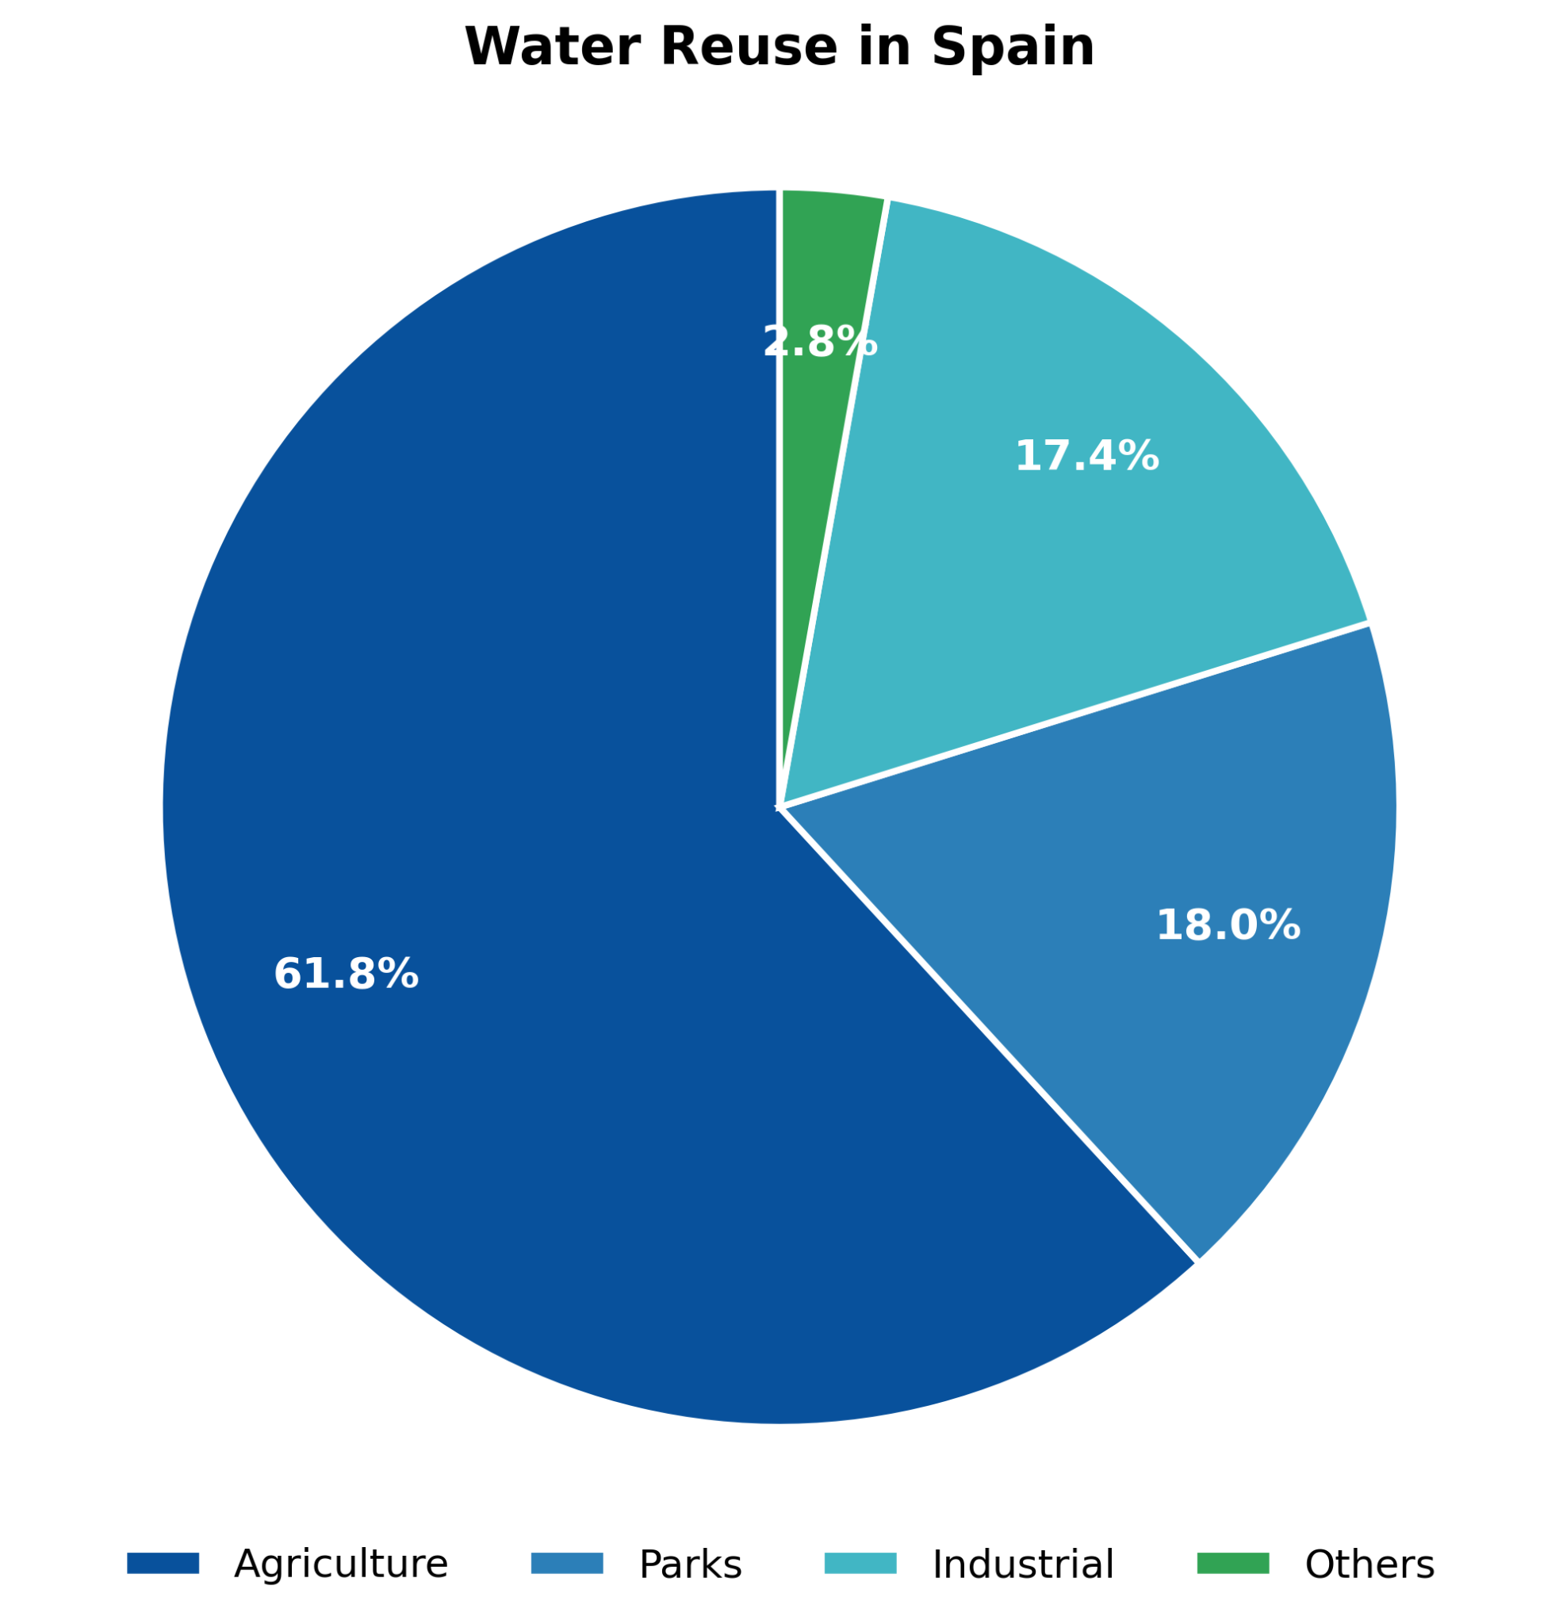
Does Wastewater Treatment Reduce Antibiotic Resistance Genes Burden?
Mada Hazazi
Reference
Background
Treated wastewater is increasingly reused to maintain sustainability
Antimicrobial resistance (AMR) is a growing global health threat wastewater is a key environmental reservoir and dispersal route for resistance genes
Filtration reduces microbial load, but doesn't necessarily eliminate genetic material or the risk of multidrug-resistant (MDR) organisms surviving treatment
Reference
Notes:
Treated wastewater
Place for growth
Regulation to control as risk management

Slide 10

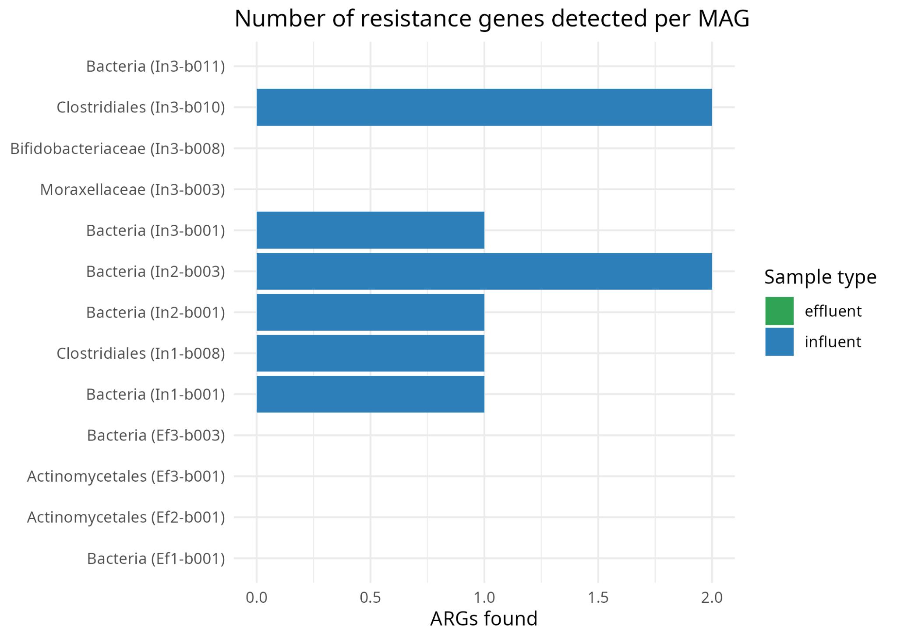
Does Wastewater Treatment Reduce Antibiotic Resistance Genes Burden?
Mada Hazazi
Reference
Workflow
Sample | 6 (3 before treatment, 3 after treatment)
Genome bins | 52
Genome bins passed quality filter | 13
Bins with resistance gene | 6

Slide 11
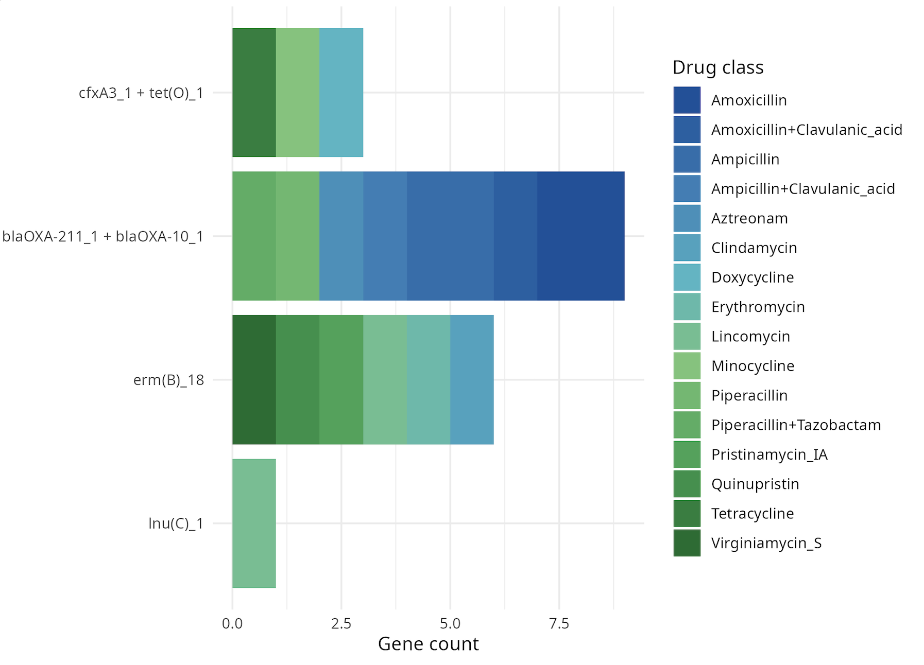
Does Wastewater Treatment Reduce Antibiotic Resistance Genes Burden?
Mada Hazazi
Reference
Key findings
0/4 post-treatment and 6/9 pre-treatment passed quality filter with a resistance genes
2/6 genes shows multidrug resistance pattern

Slide 12
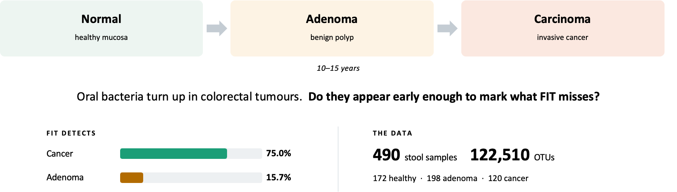
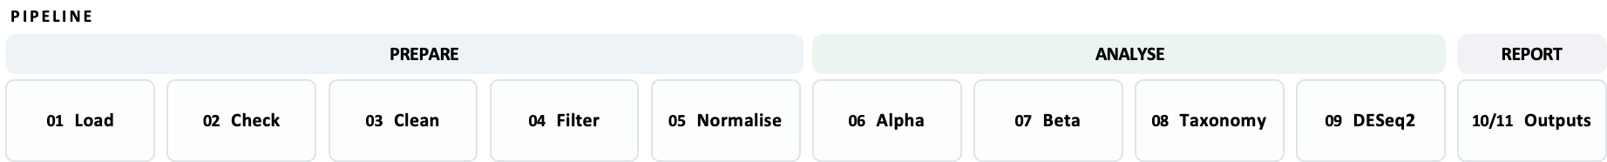
How does the gut microbiome change across the adenoma–carcinoma sequence, and which microbial signatures distinguish healthy, adenoma and colorectal cancer patients?
Fadia Ashmawi (Re-analysis of Baxter et al. (2016) Genome Medicine 8:37- 490 stool samples, 16S rRNA V4)

Slide 13
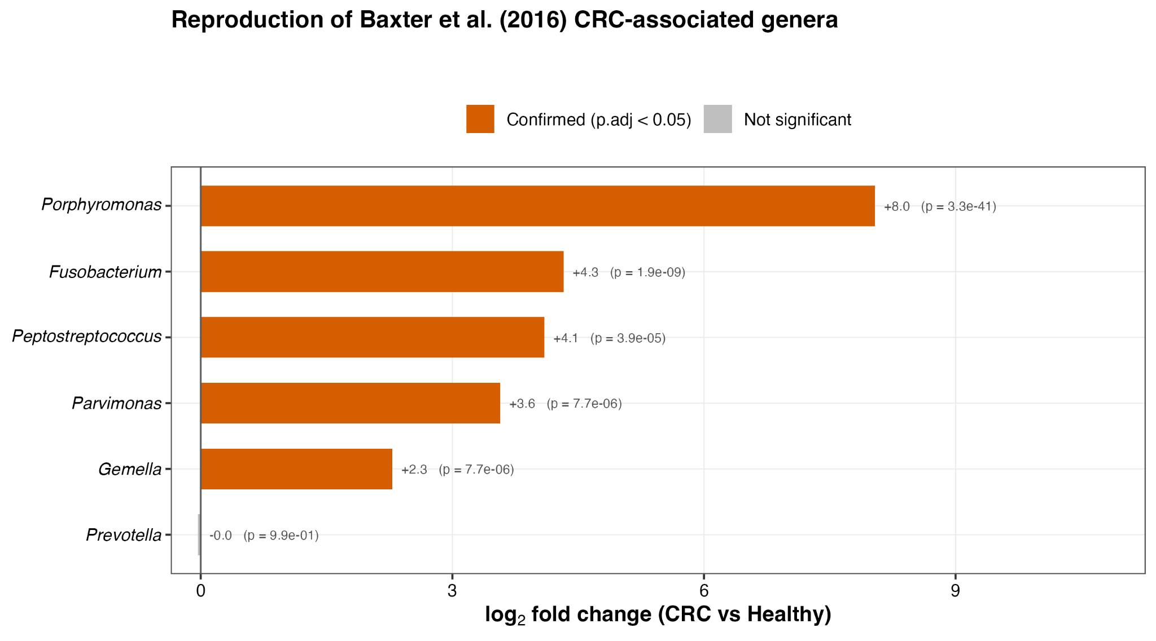
How does the gut microbiome change across the adenoma–carcinoma sequence, and which microbial signatures distinguish healthy, adenoma and colorectal cancer patients?
Reproduction of Baxter et al. (2016) CRC-associated genera
Genre | Baxter et al. | This work | Replication
Cohort | 172 / 198 / 120 | 172 / 198 / 120 | Exact
Age, median | 60 (29–89) | 60 (29–89) | Exact
FIT-positive | 75.0 / 15.7 / 2.9% | 75.0 / 15.7 / 2.9% | Exact
CRC genera | 6 named | 5 of 6 recovered | Strong
Method | Random forest | Neg-binomial GLM | Independent
Lachnospiraceae | Enriched in normals | Family flat; 3 genera down | Partial
Effect of sex | p = 0.07 | p = 0.013, R² = 0.004 | Both tiny
Prevotella | One OTU enriched | Genus: not significant | Not recovered
Alpha diversity | Not reported | Chao1 p = 7.8 × 10⁻⁷ | New
They used random-forest importance inside a classifier. I used a negative-binomial GLM with FDR control. Two unrelated methods, the same five organisms — which is stronger evidence than either alone.
Fadia Ashmawi (Re-analysis of Baxter et al. (2016) Genome Medicine 8:37- 490 stool samples, 16S rRNA V4)

Slide 14
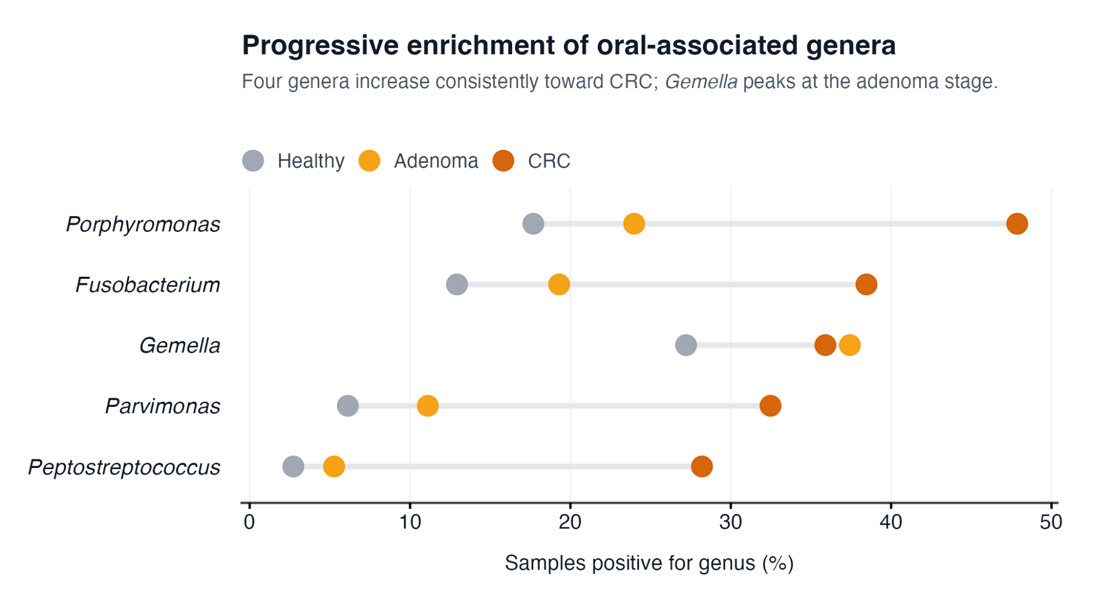
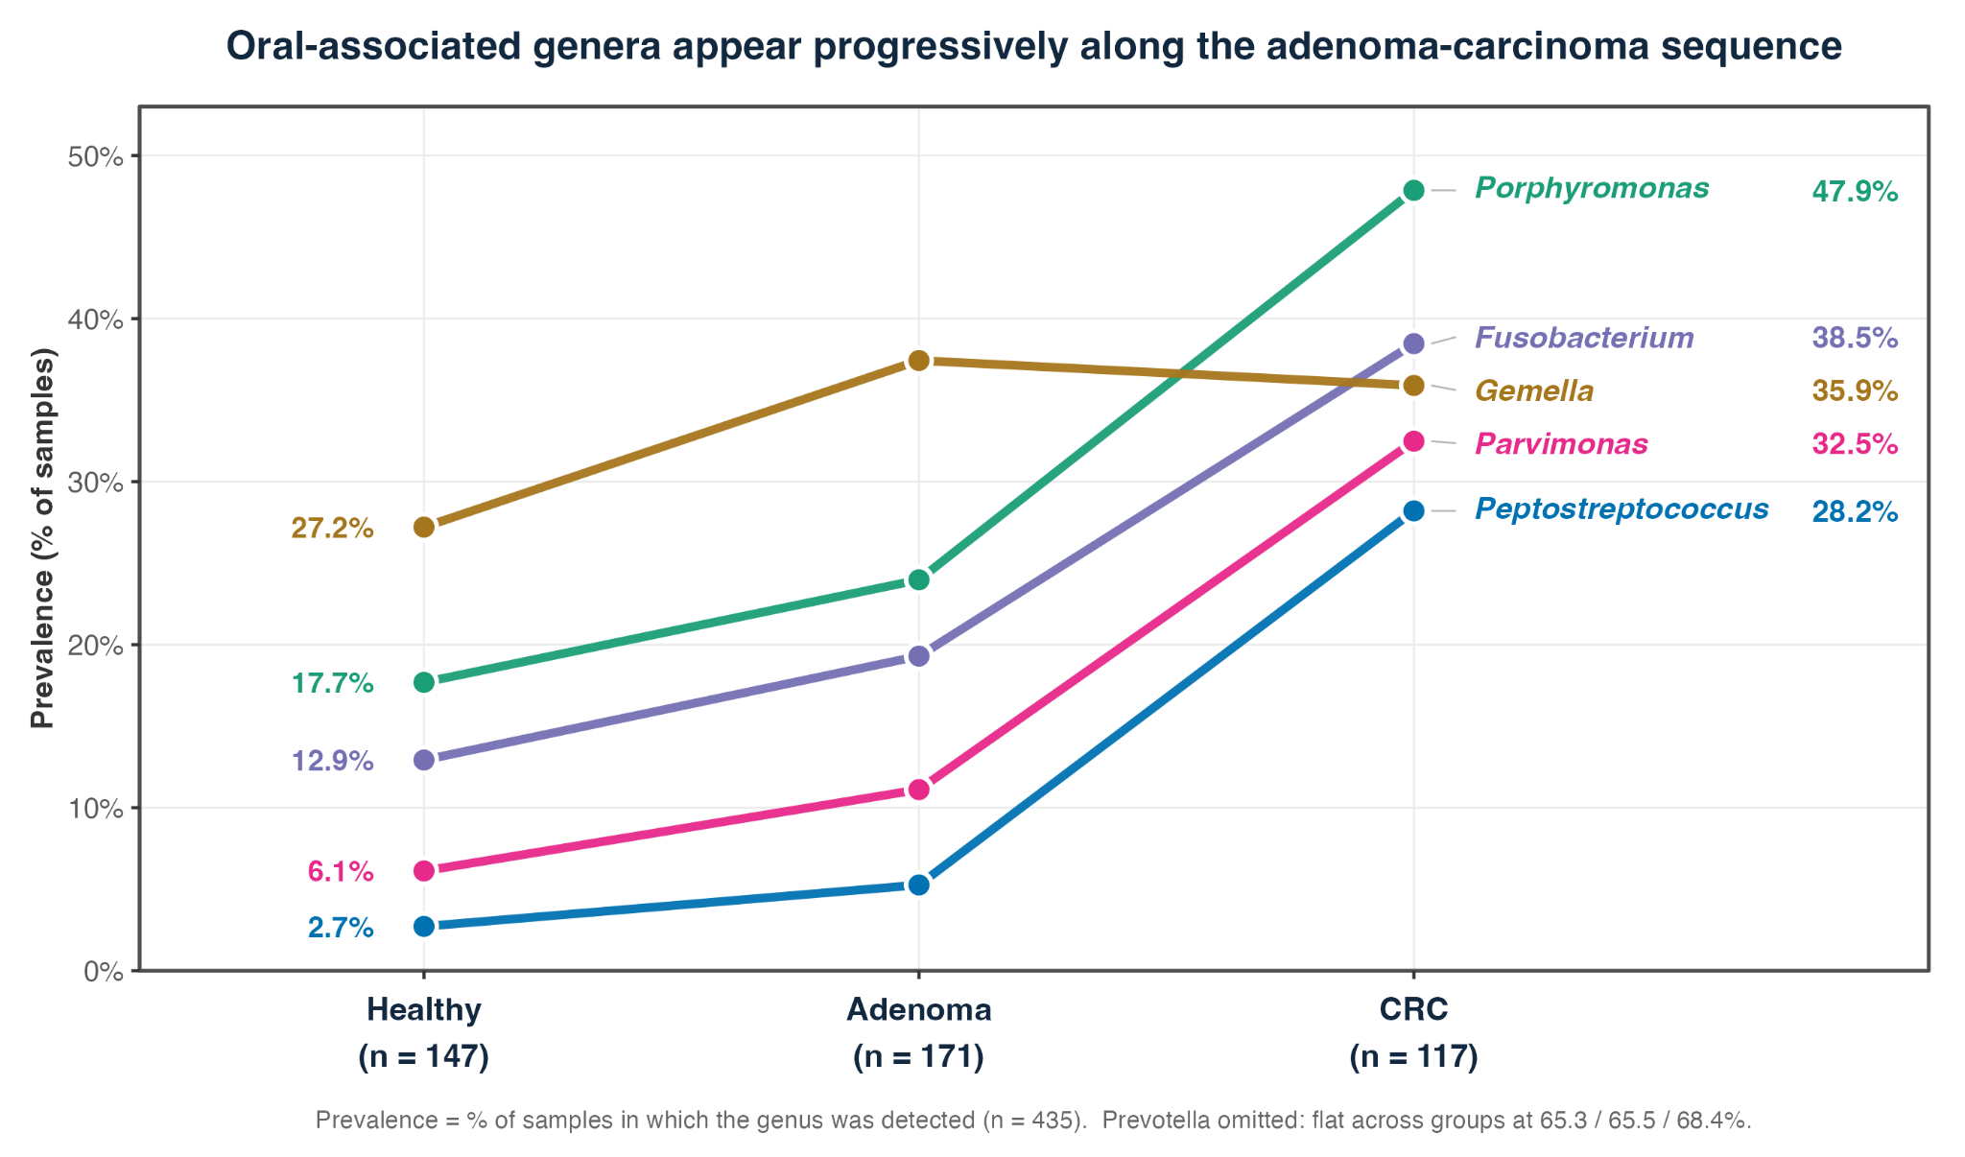
How does the gut microbiome change across the adenoma–carcinoma sequence, and which microbial signatures distinguish healthy, adenoma and colorectal cancer patients?
Results: Richness decreased significantly in carcinoma, while abundance-weighted diversity remained unchanged, indicating a loss of rare taxa. Five oral-associated genera increased progressively across the adenoma–carcinoma sequence, with adenoma showing an intermediate microbial profile.
Improvements: Future work should use compositionally aware methods (e.g., ANCOM-BC or ALDEx2), analyse adenoma subtypes separately, perform OTU/ASV-level analyses, and validate findings with a random forest classifier and an age-matched cohort.
Fadia Ashmawi (Re-analysis of Baxter et al. (2016) Genome Medicine 8:37- 490 stool samples, 16S rRNA V4)

Slide 15
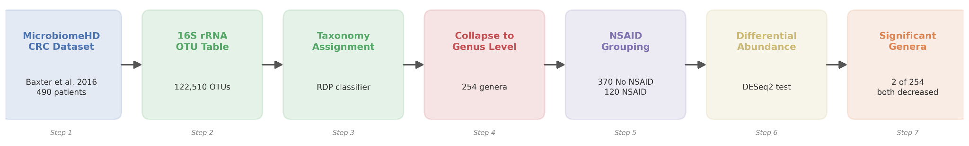
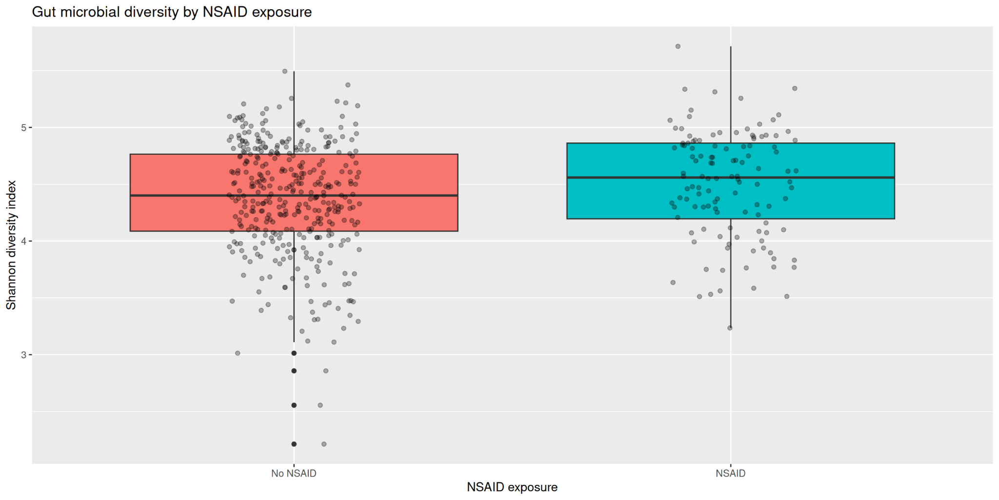
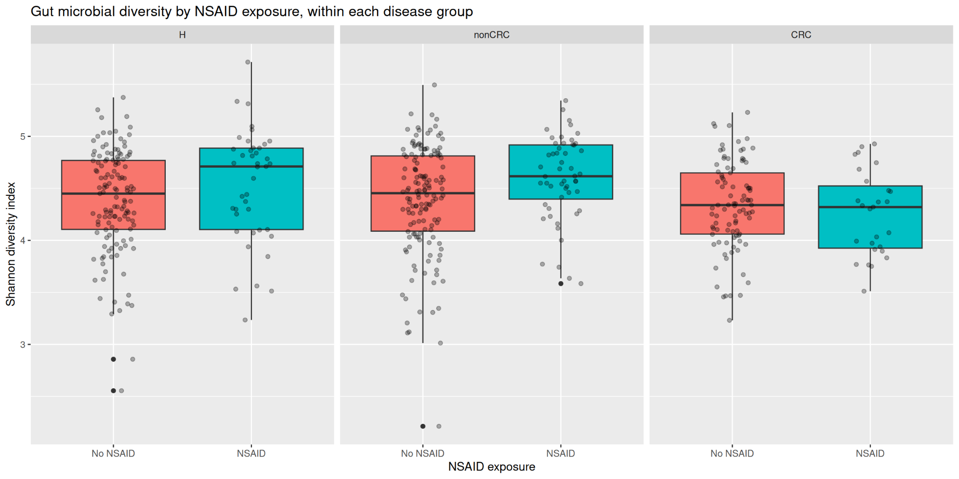
Does NSAID Use Shape the Gut Microbiome in Colorectal Cancer Patients?
~ Dalia
Re-analysis of Baxter et al. (2016) Genome Medicine 8:37- 490 stool samples, 16S rRNA V4

Slide 16
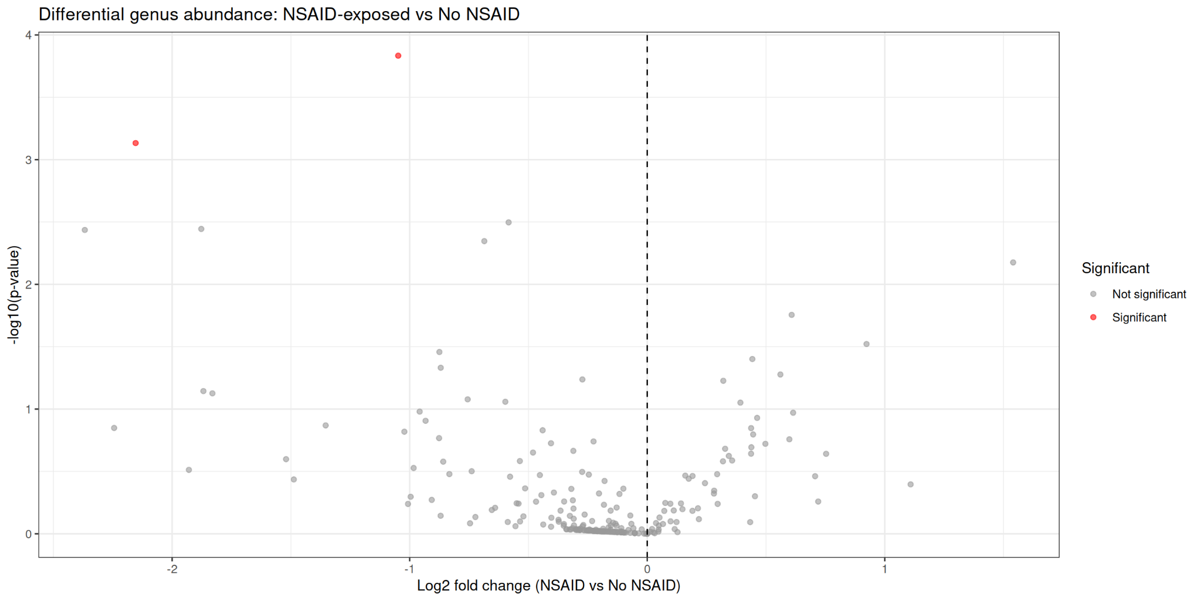
Does NSAID Use Shape the Gut Microbiome in Colorectal Cancer Patients?
~ Dalia
Results
Gut microbial diversity significantly higher in NSAID-exposed patients (p = 0.012), strongest in the adenoma subgroup (p = 0.007)
2 of 254 genera significantly different, Erysipelotrichaceae_incertae_sedi and Porphyromonas both decreased with NSAID exposure, including Porphyromonas, a known CRC-associated pathogen (Duvallet et al. 2017)
Limitations
Cross-sectional data; association only, not causation
NSAID recorded as a whole drug class, not dose or duration
Single dataset; hypothesis-generating, needs validation
Re-analysis of Baxter et al. (2016) Genome Medicine 8:37- 490 stool samples, 16S rRNA V4

Slide 17
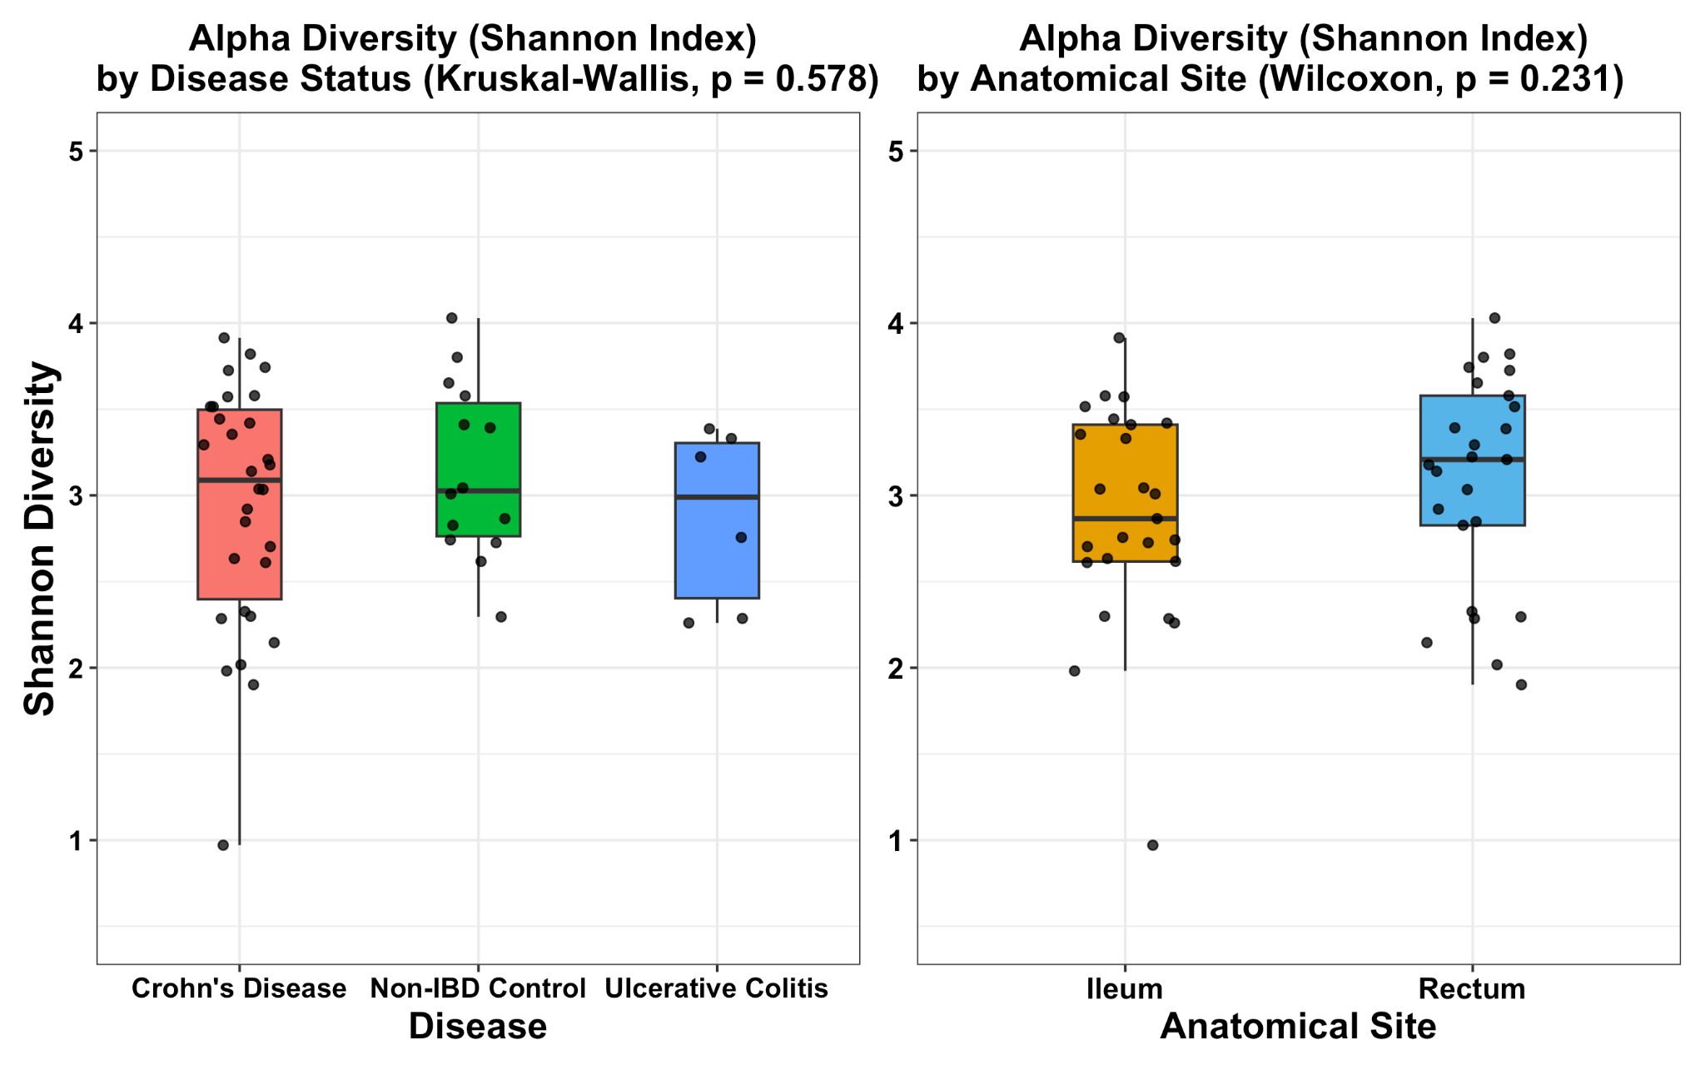
16S rRNA Gene Analysis Pipeline for the HMP2 Inflammatory Bowel Disease Cohort
Project Overview
Human Microbiome Project 2 (HMP2) 16S rRNA gene sequencing dataset
Human gut biopsy samples from the ileum and rectum
Study groups: Crohn’s disease, Ulcerative colitis, and healthy controls
DADA2 pipeline for quality control, ASV inference, and chimera removal
Taxonomic assignment using the SILVA v138.2 reference database
Alpha diversity analysis (Shannon index)
Beta diversity analysis (Bray–Curtis NMDS and PERMANOVA)
Relative abundance analysis of the top 20 bacterial genera
Turky AlSulaiman

Slide 18
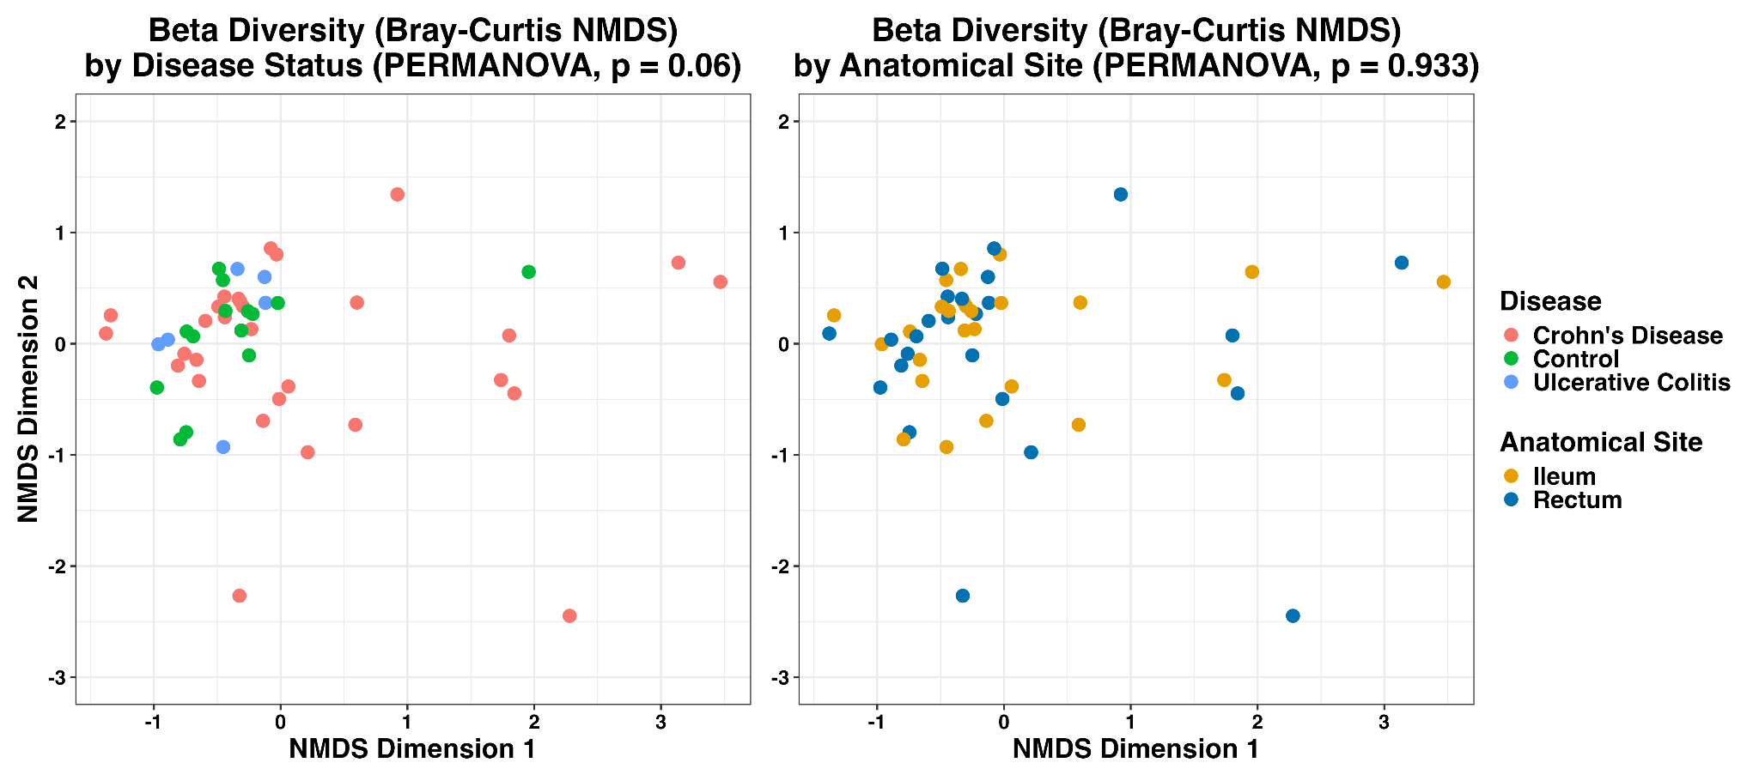
16S rRNA Gene Analysis Pipeline for the HMP2 Inflammatory Bowel Disease Cohort
Turky AlSulaiman

Slide 19
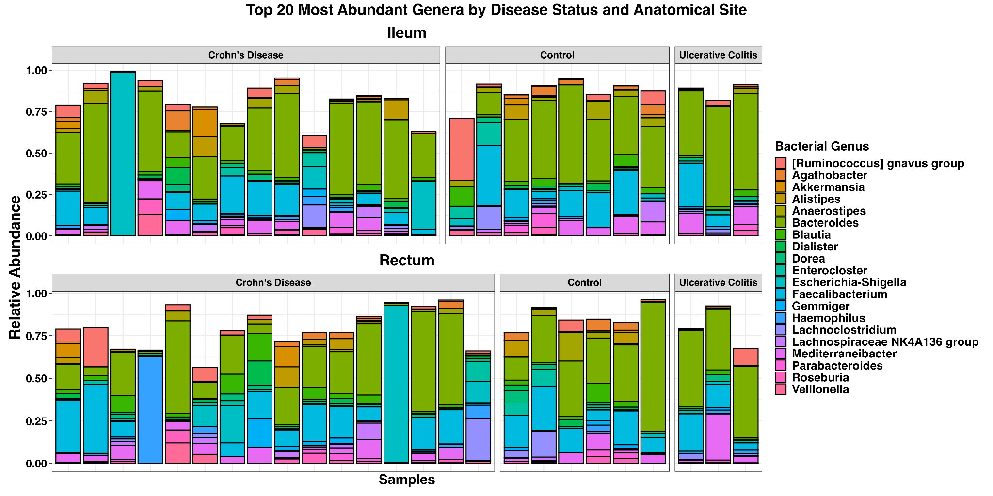
16S rRNA Gene Analysis Pipeline for the HMP2 Inflammatory Bowel Disease Cohort
Turky AlSulaiman

Slide 20
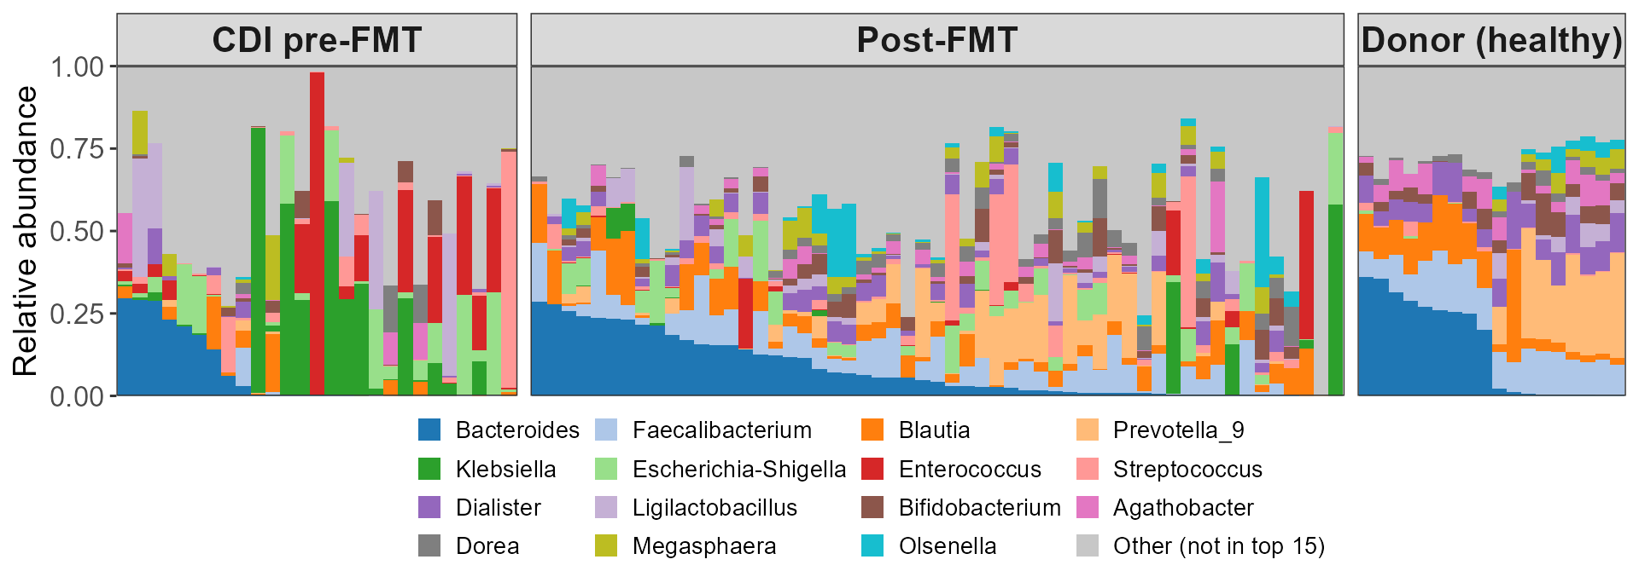
Every patient's gut is broken differently; every donor's looks the same
RESULT: Patients share no common disrupted state - each is dominated by a different organism
Data: Duvallet et al. 2017, Nat Commun (s41467-017-01973-8) - cdi_youngster study, Youngster et al. 2014, Clin Infect Dis 58:1515. 100 stool samples from 23 people: 19 patients sampled before and after FMT, plus 4 healthy donors. 16S rRNA V4, 100%-identity OTUs named against SILVA v138.1 (92% to genus), pooled into 286 genera holding 95.1% of reads. Top 15 genera shown; grey = all others.
Ryan: CDI & FMT
Notes:
Slide 1 — Every patient's gut is broken differently; every donor's looks the same
"286 genera; 169 appeared in at least 10% of people so were worth testing; a Wilcoxon test on each, then Benjamini-Hochberg to correct for 169 tests, left 53 — 51 depleted in patients, 2 enriched.“
Dataset
Youngster et al. (2014)
19 patients + 4 healthy donors
100 stool samples
Repeated patient samples averaged → 23 individuals for statistics
Explain the figure
Each bar = one stool sample
Colours = 15 most abundant bacteria
Grey = all remaining bacteria
Left (Patients before FMT)
Every patient sample looks different
Different bacteria dominate each sample
No common specific "disease microbiome“
Right (Donors)
Donors look remarkably similar
Stable, healthy microbial community
Only 4 Donors
Middle (Patients after FMT)
Patients shift toward donor composition
Gut becomes more similar to healthy donors
Main takeaway
Many ways for a gut to become unhealthy, but common stable healthy state.

Slide 21
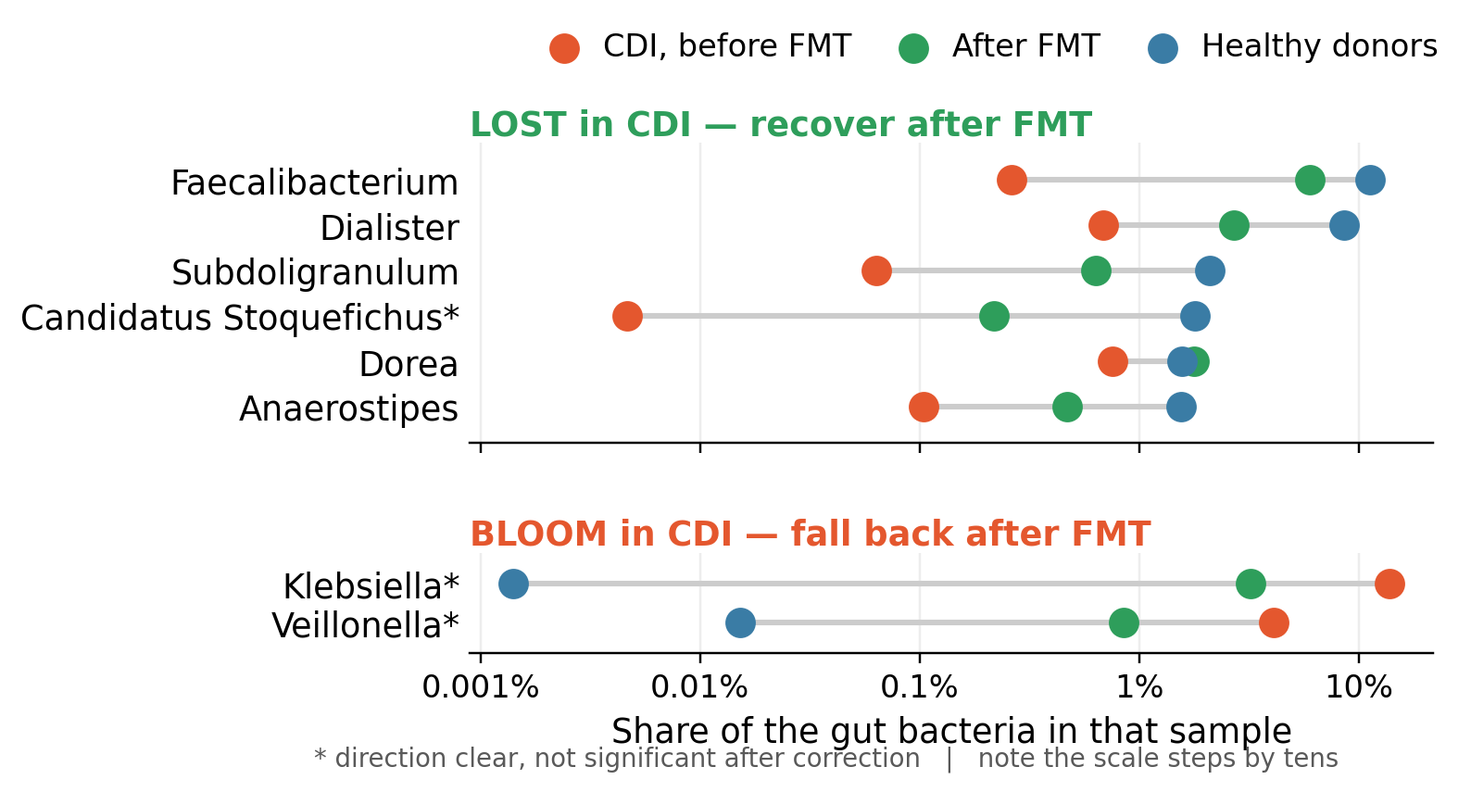
The fibre-fermenters come back; the invaders fall away
RESULT: The good bacteria wiped out by infection come back after the FMT transplant; the ones that took over fades
53 genera differ: Between patients and donors. 51 depleted, only 2 enriched
What is lost: Fibre-fermenting anaerobes. They make butyrate, which fuels the colon lining and keeps the gut oxygen-free
What moves in: Klebsiella and Veillonella; Opportunists that grow once that oxygen-free state is gone
After FMT: The anaerobes return, but not fully.
Genera selected by Wilcoxon test, CDI patients vs donors, Benjamini-Hochberg q < 0.05. Shown: the 6 depleted genera most abundant in donors, plus both enriched genera. * = movement after FMT not significant after correction (Klebsiella q = 0.054, Veillonella q = 0.096).
Ryan: CDI & FMT
Notes:
Slide 2 — Fibre fermenters return, opportunists disappear
Differential abundance
Compared 169 genera
53 significantly different
51 enriched in healthy donors
Only 2 enriched in patients
Top panel
Six most depleted beneficial genuses
Red = before
Green = after
Blue = donors
Key point
Faecalibacterium nearly absent before FMT
Returns toward donor levels after treatment
Most beneficial bacteria recover substantially
Bottom panel
Two bacteria enriched in patients
Klebsiella especially abundant before treatment
Drops slighty after FMT compared to the healthy
Biological explanation (Most important)
Beneficial bacteria ferment fibre
Produce butyrate
Butyrate fuels colon cells
Colon cells consume oxygen
Low oxygen prevents pathogens like Klebsiella to grow
FMT restores this healthy environment
The microbiome only got about halfway back, but people felt completely better even if it was still only partly restored.
Main takeaway
FMT restores beneficial bacteria rather than directly killing pathogens and restores the healthy gut environment.
Important numbers
Item
Value
Patients 19
Donors 4
Total samples 100
Individuals analysed 23
Genera tested 169
Significant genera 53
Depleted genera 51
Enriched genera 2
Faecalibacterium 0.26% → 5.98% (donors 11.29%)
Klebsiella 13.8% → 3.2% (donors ~0%)
Limitations
Only 4 donors.
Single clinical study.
Repeated sampling handled by averaging.
Genus-level resolution only.
Function inferred, not directly measured.

Slide 22
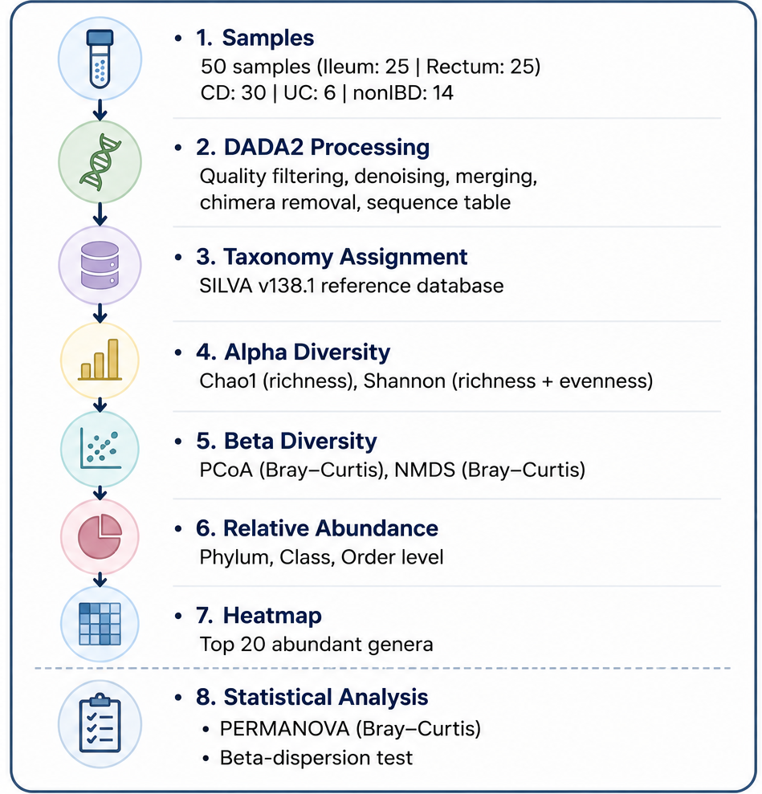
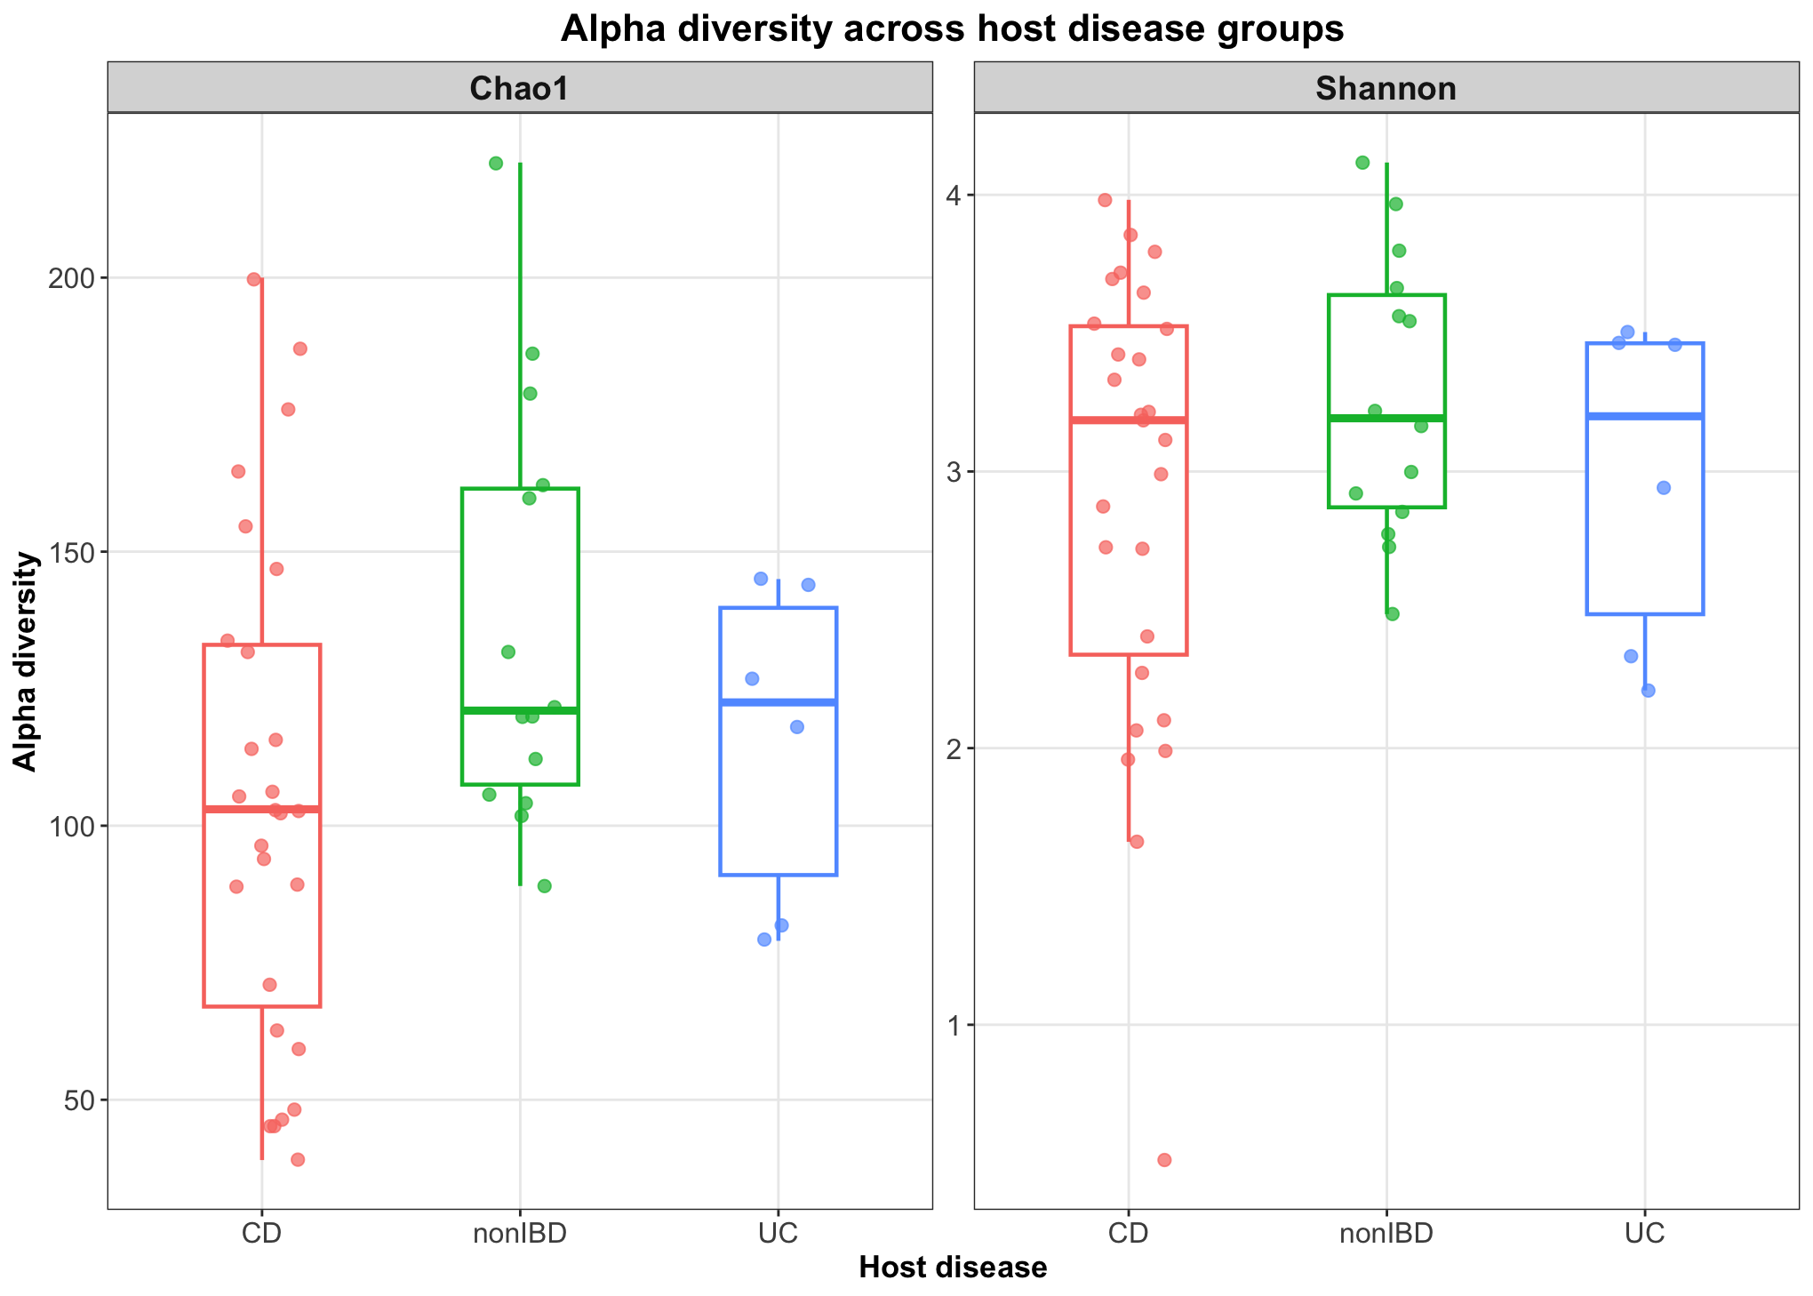
How does the gut microbiome differ between CD, UC, and nonIBD individuals?
CD samples showed lower alpha diversity than nonIBD, while UC displayed intermediate diversity.
Lames

Slide 23
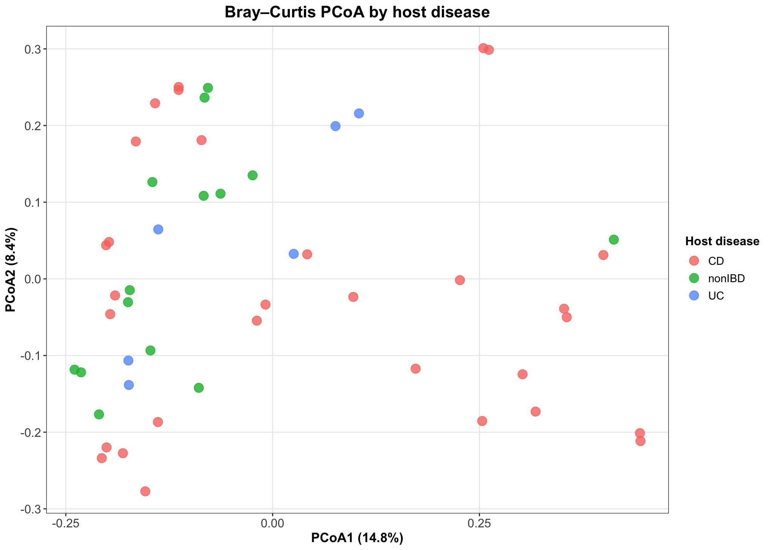
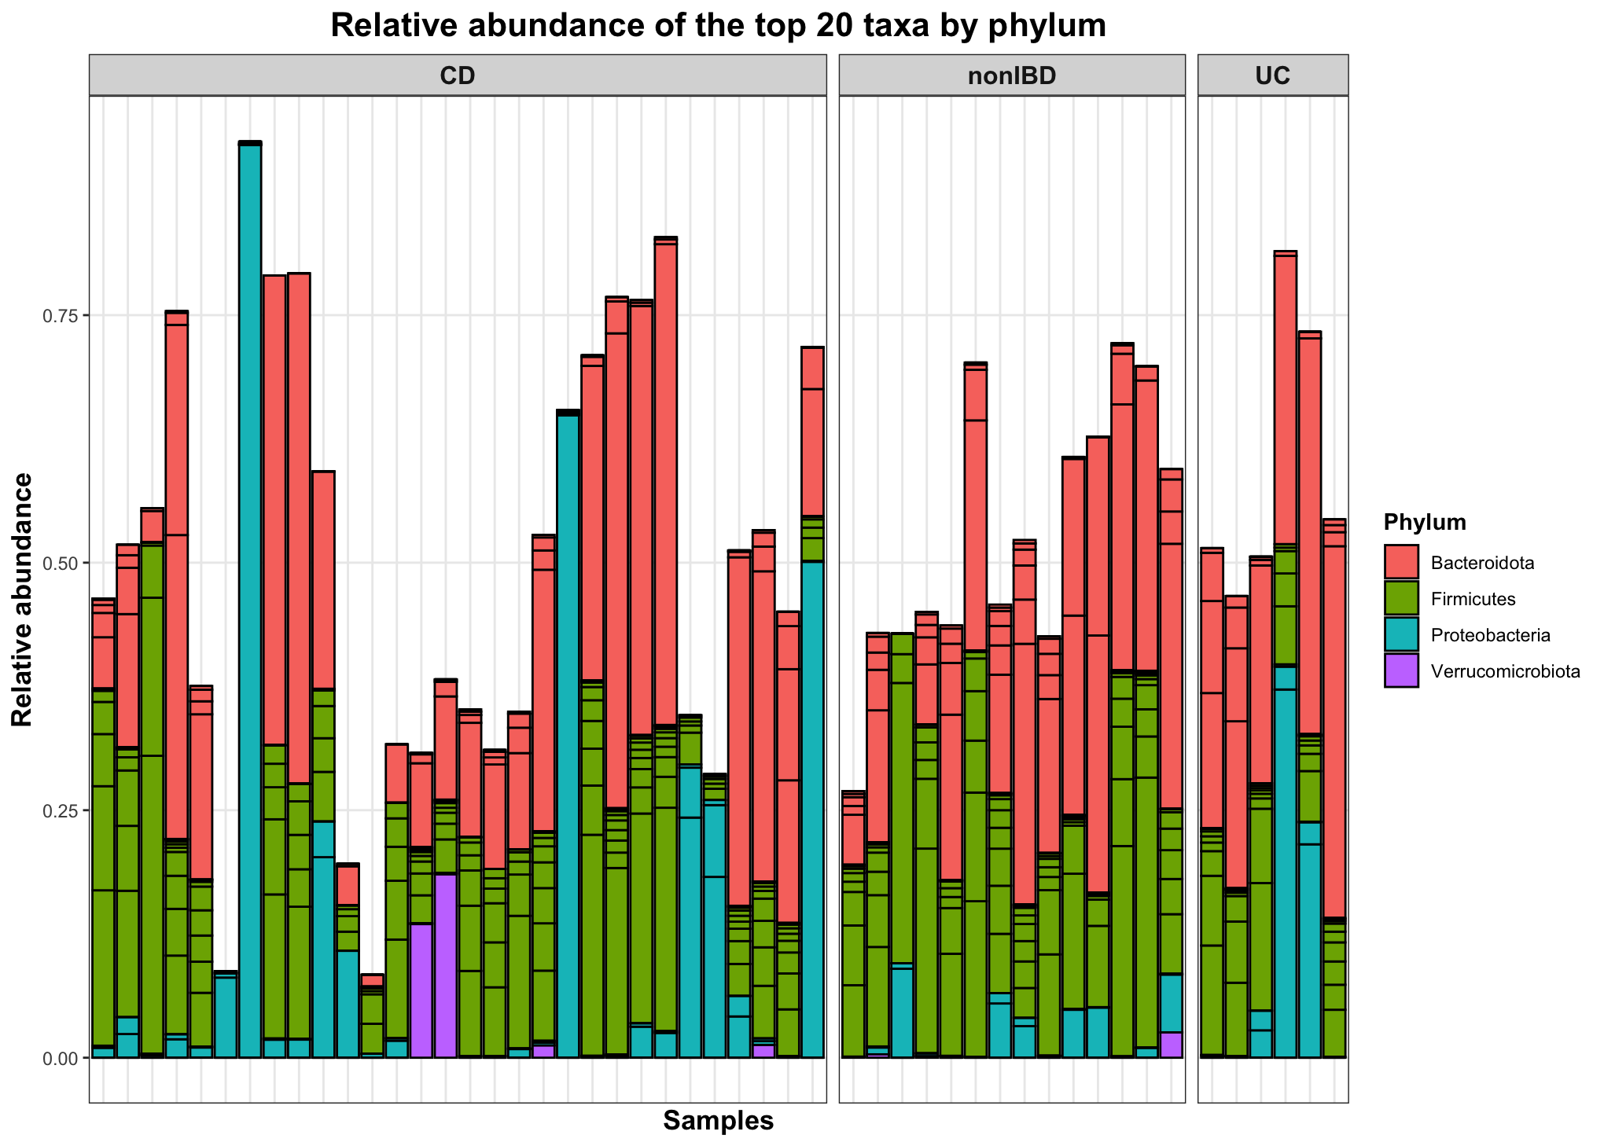
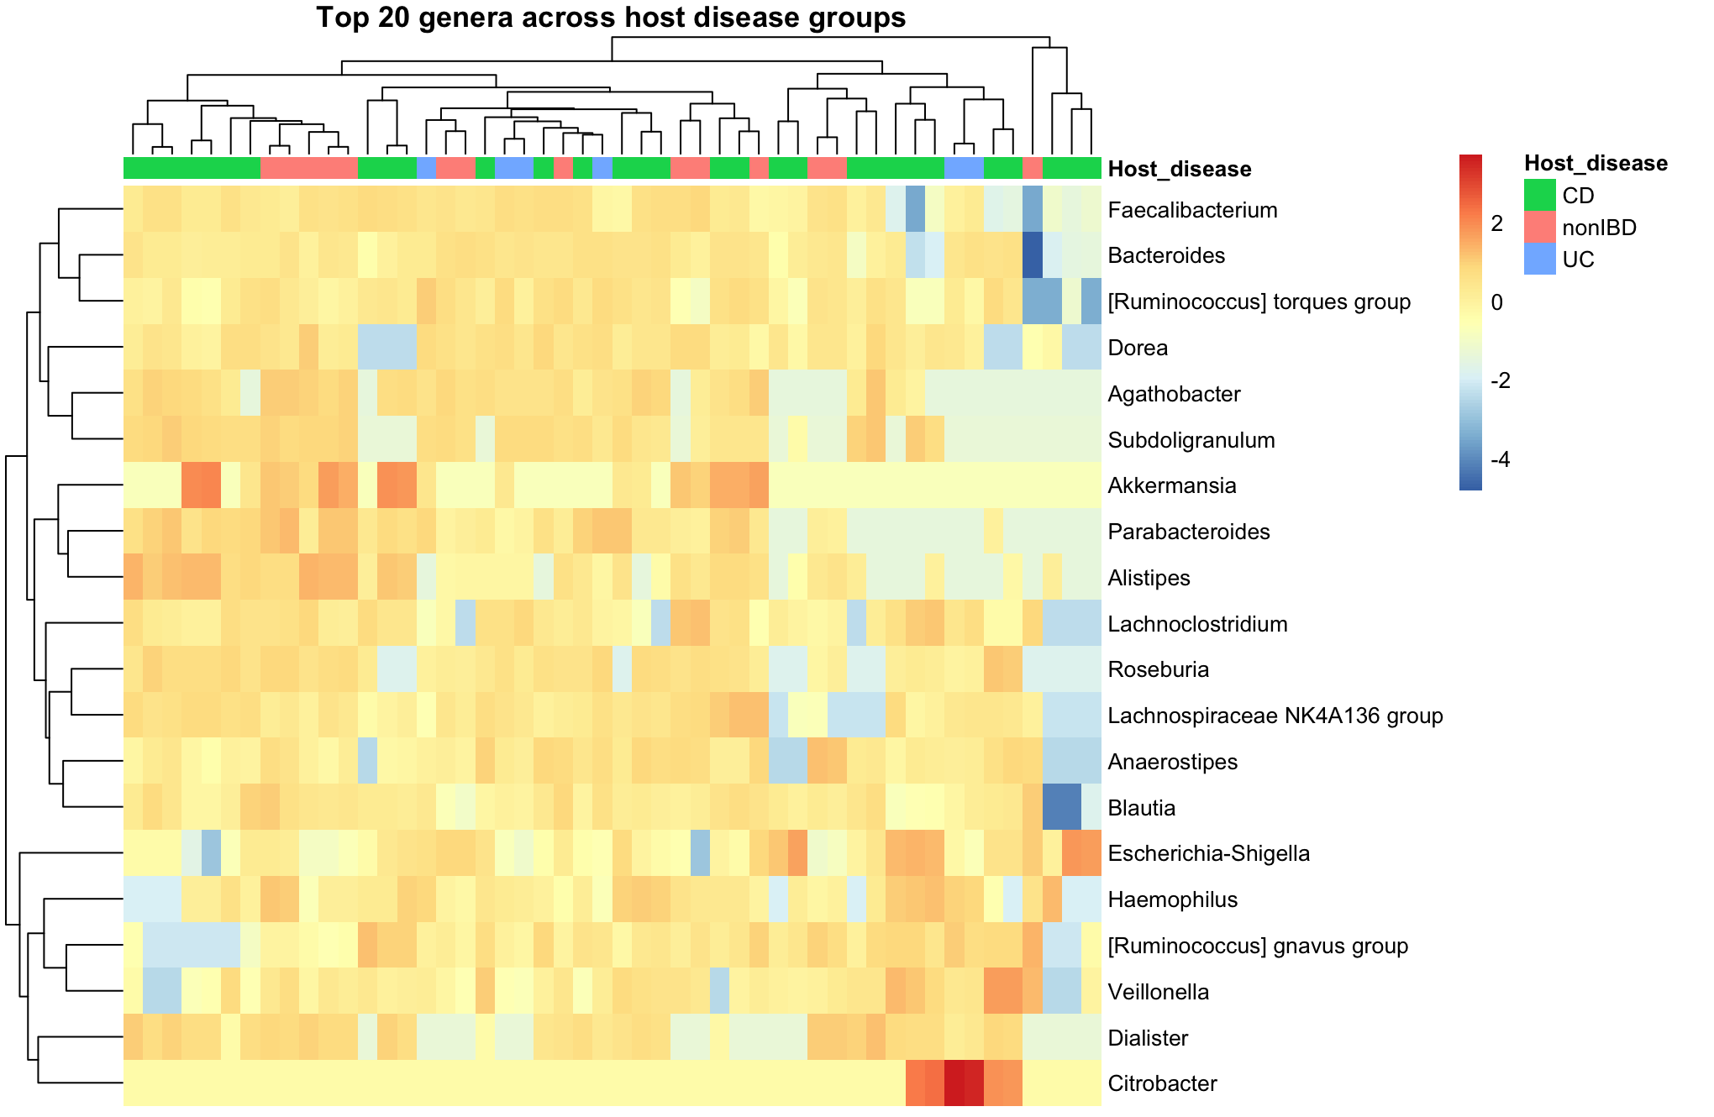
How does the gut microbiome differ between CD, UC, and nonIBD individuals?
Host disease significantly influenced overall gut microbial composition
PERMANOVA:
Host disease R² = 0.065, p = 0.005;
isolation source R² = 0.013, p = 0.977.
The overall microbial community composition was similar across groups, with no complete separation between CD, UC, and nonIBD.
CD samples exhibited greater inter-individual variability than nonIBD and UC.
PCoA revealed substantial overlap between disease groups, indicating modest disease-associated differences.
Lames

Slide 24
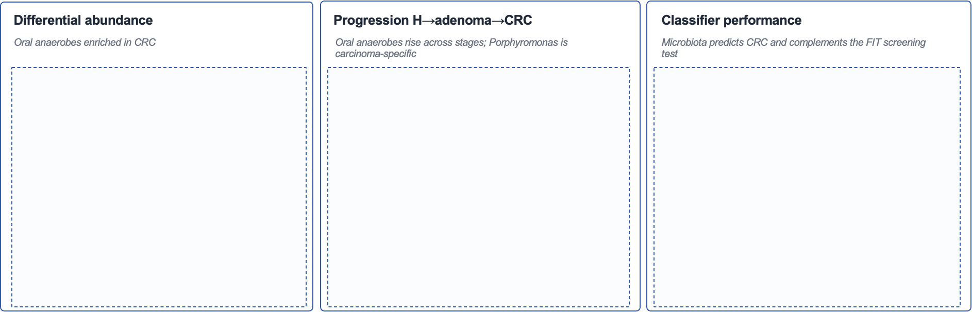
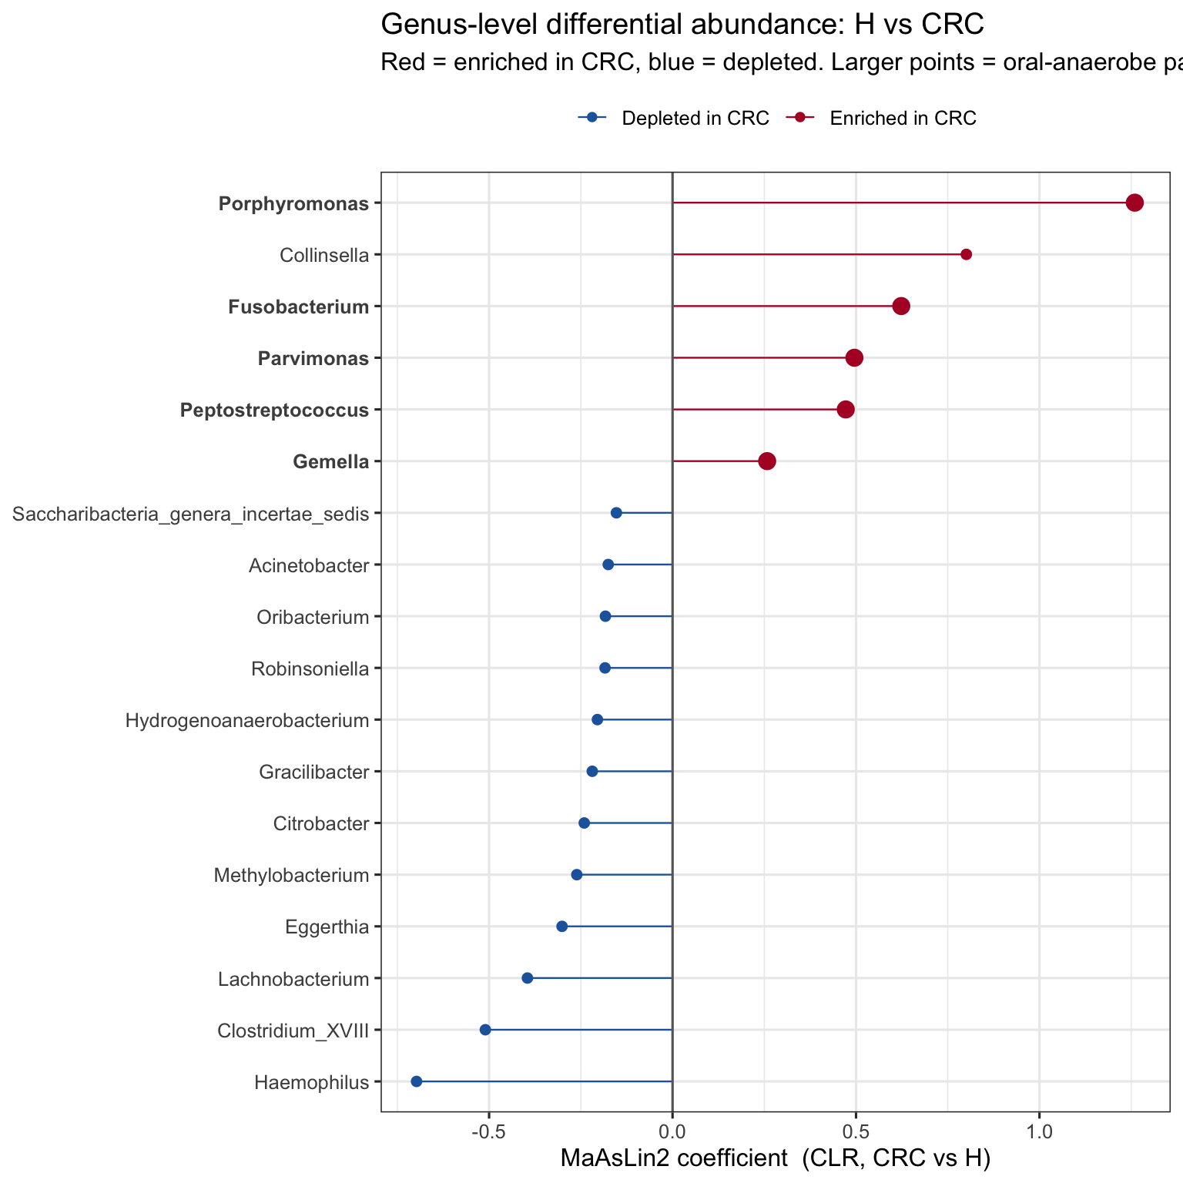
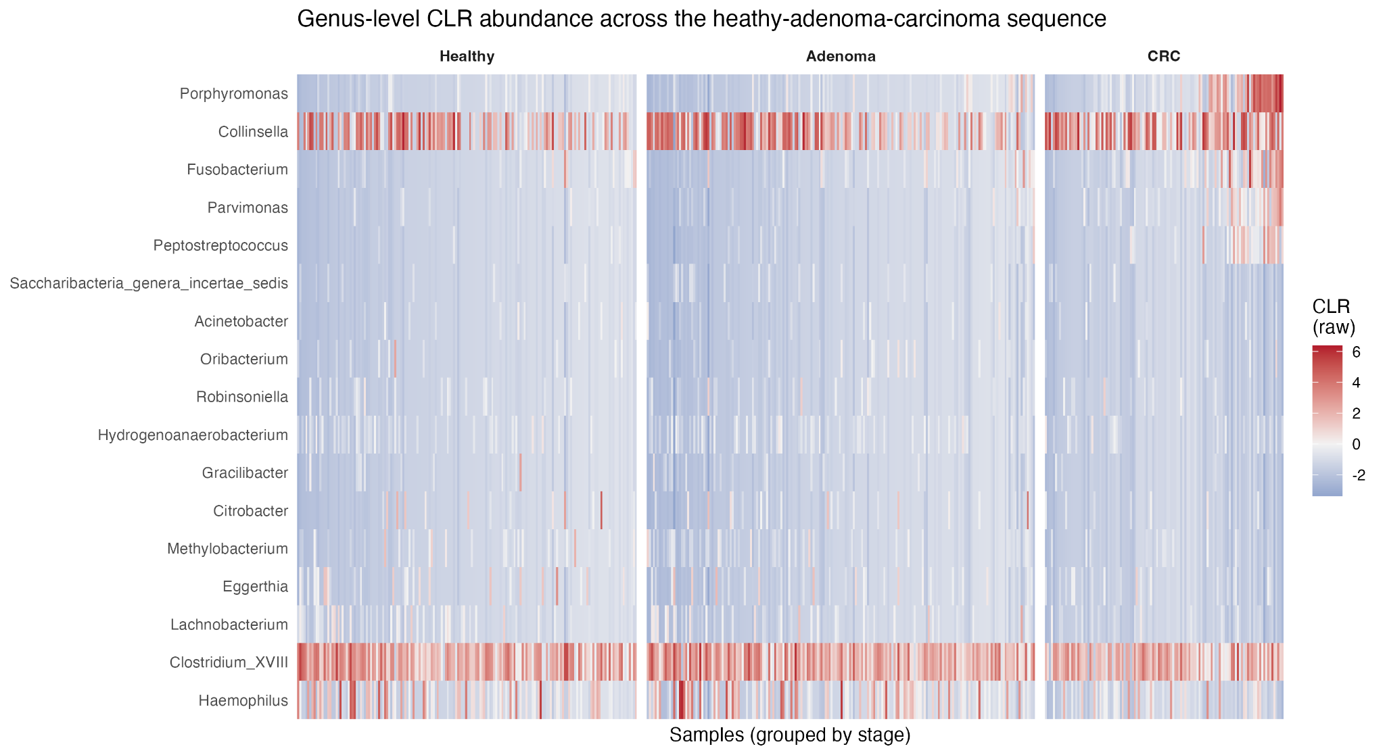
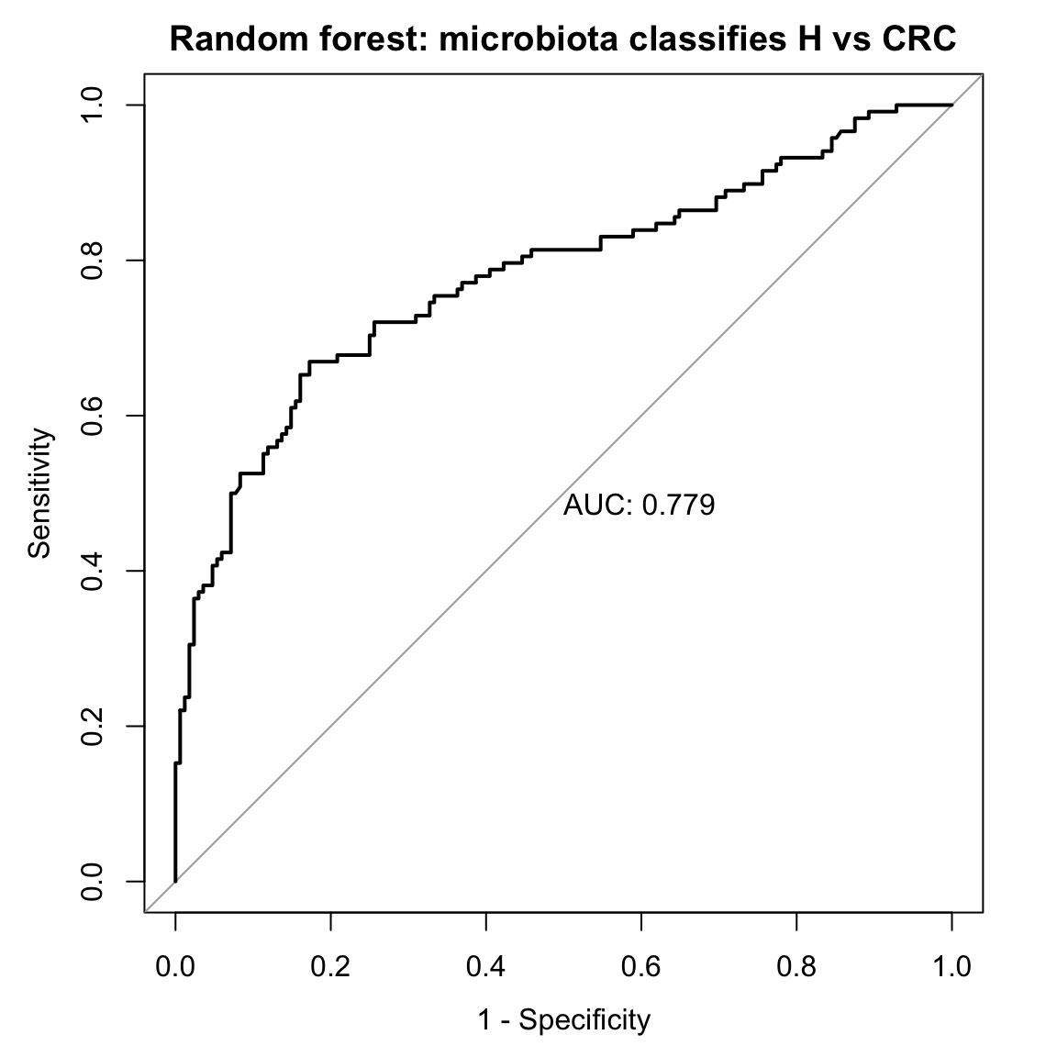
Pipeline & results: healthy vs colorectal cancer, genus-level 16S
Lena Alghamdi

Slide 25
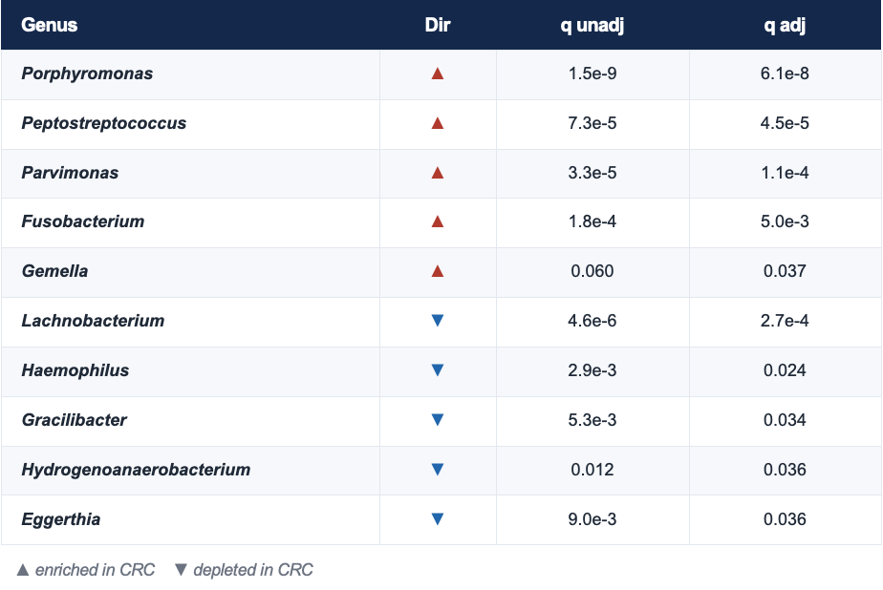

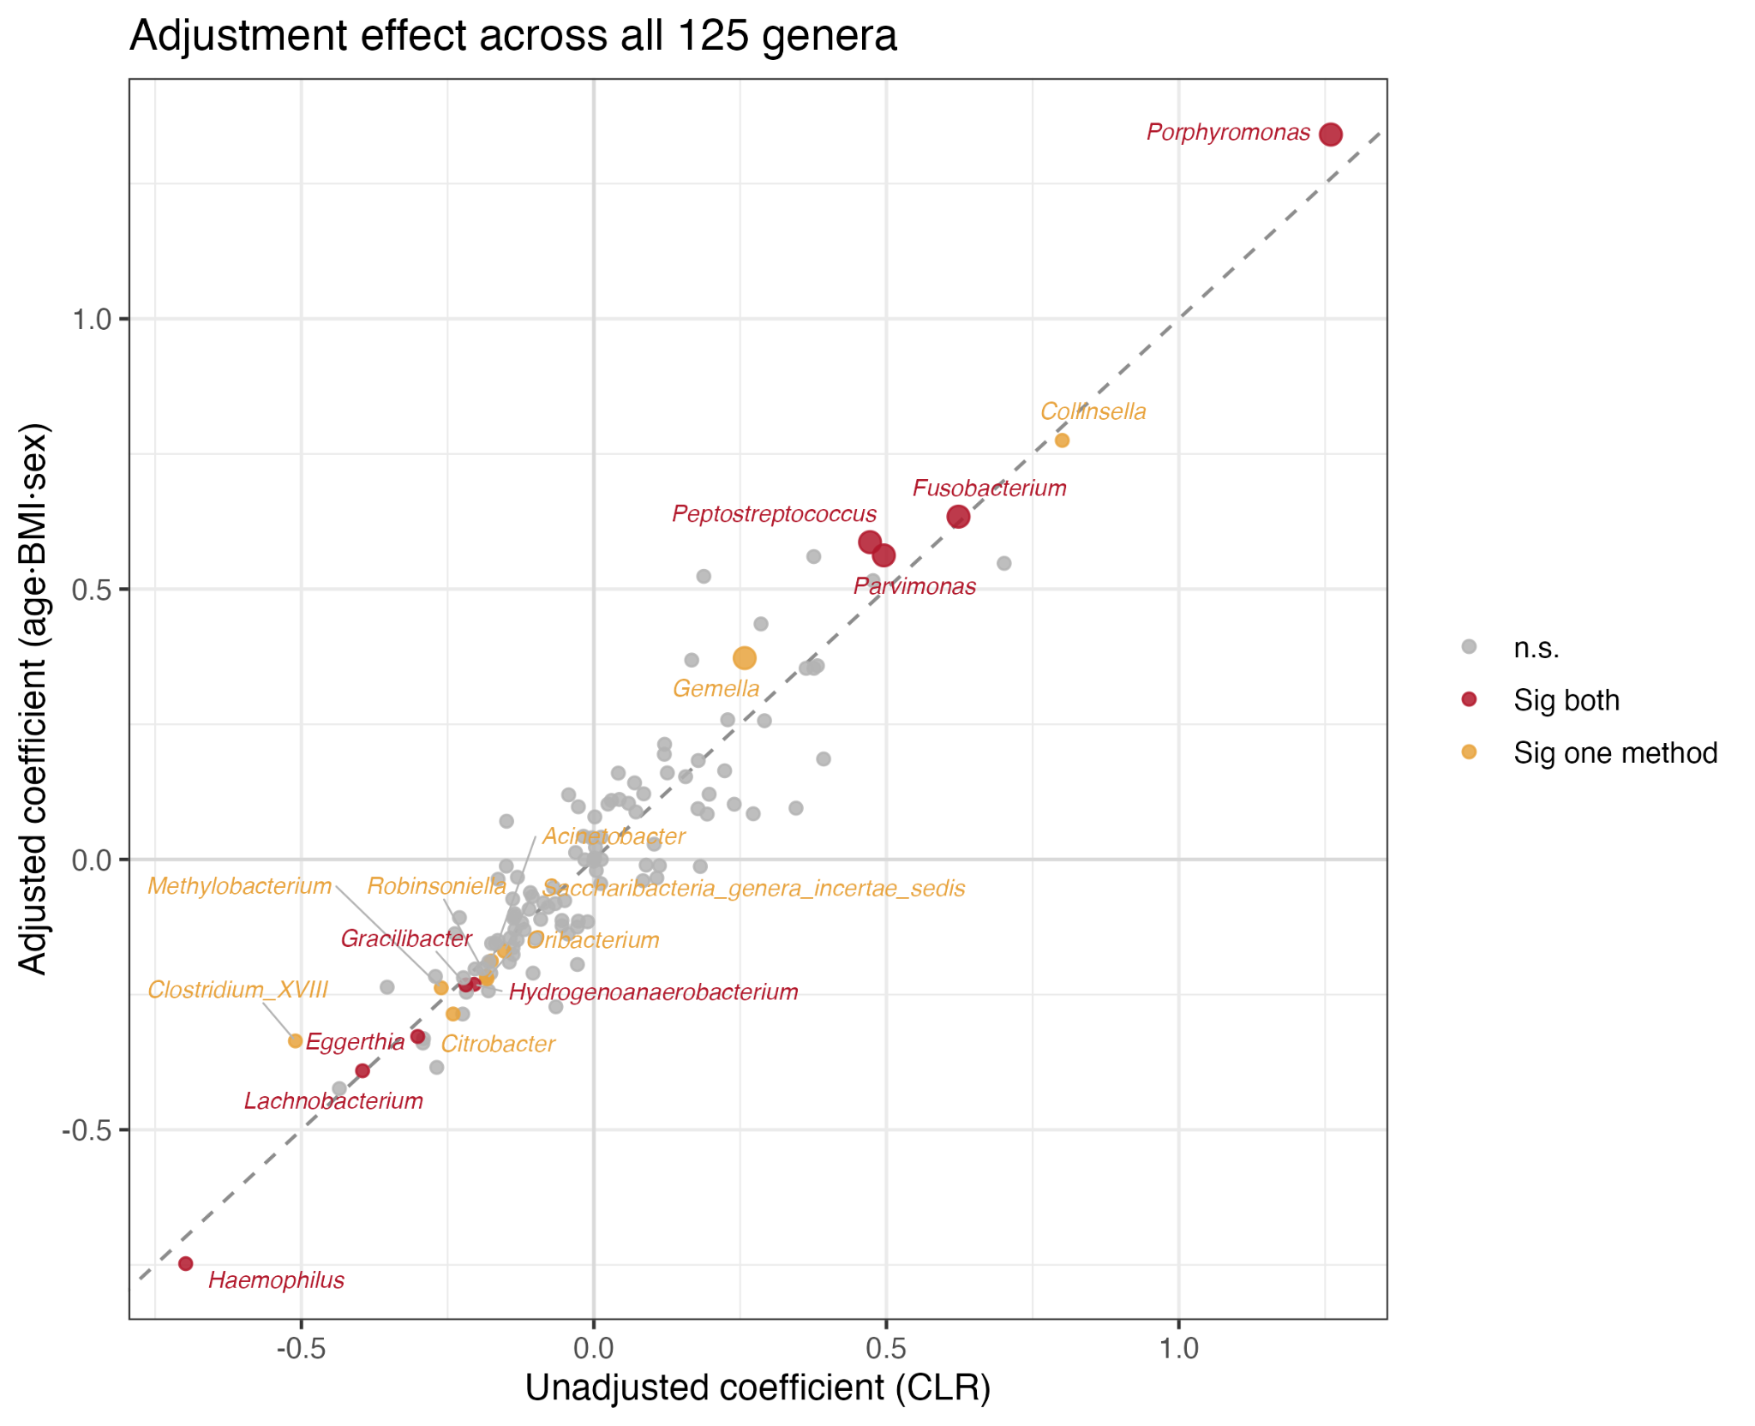
Does the signal survive adjustment for age, BMI and sex?
Lost significance after adjustment (partly demographic): Collinsella, Clostridium_XVIII, Methylobacterium, Citrobacter, Robinsoniella, Oribacterium, Acinetobacter.
Lena Alghamdi

Slide 26
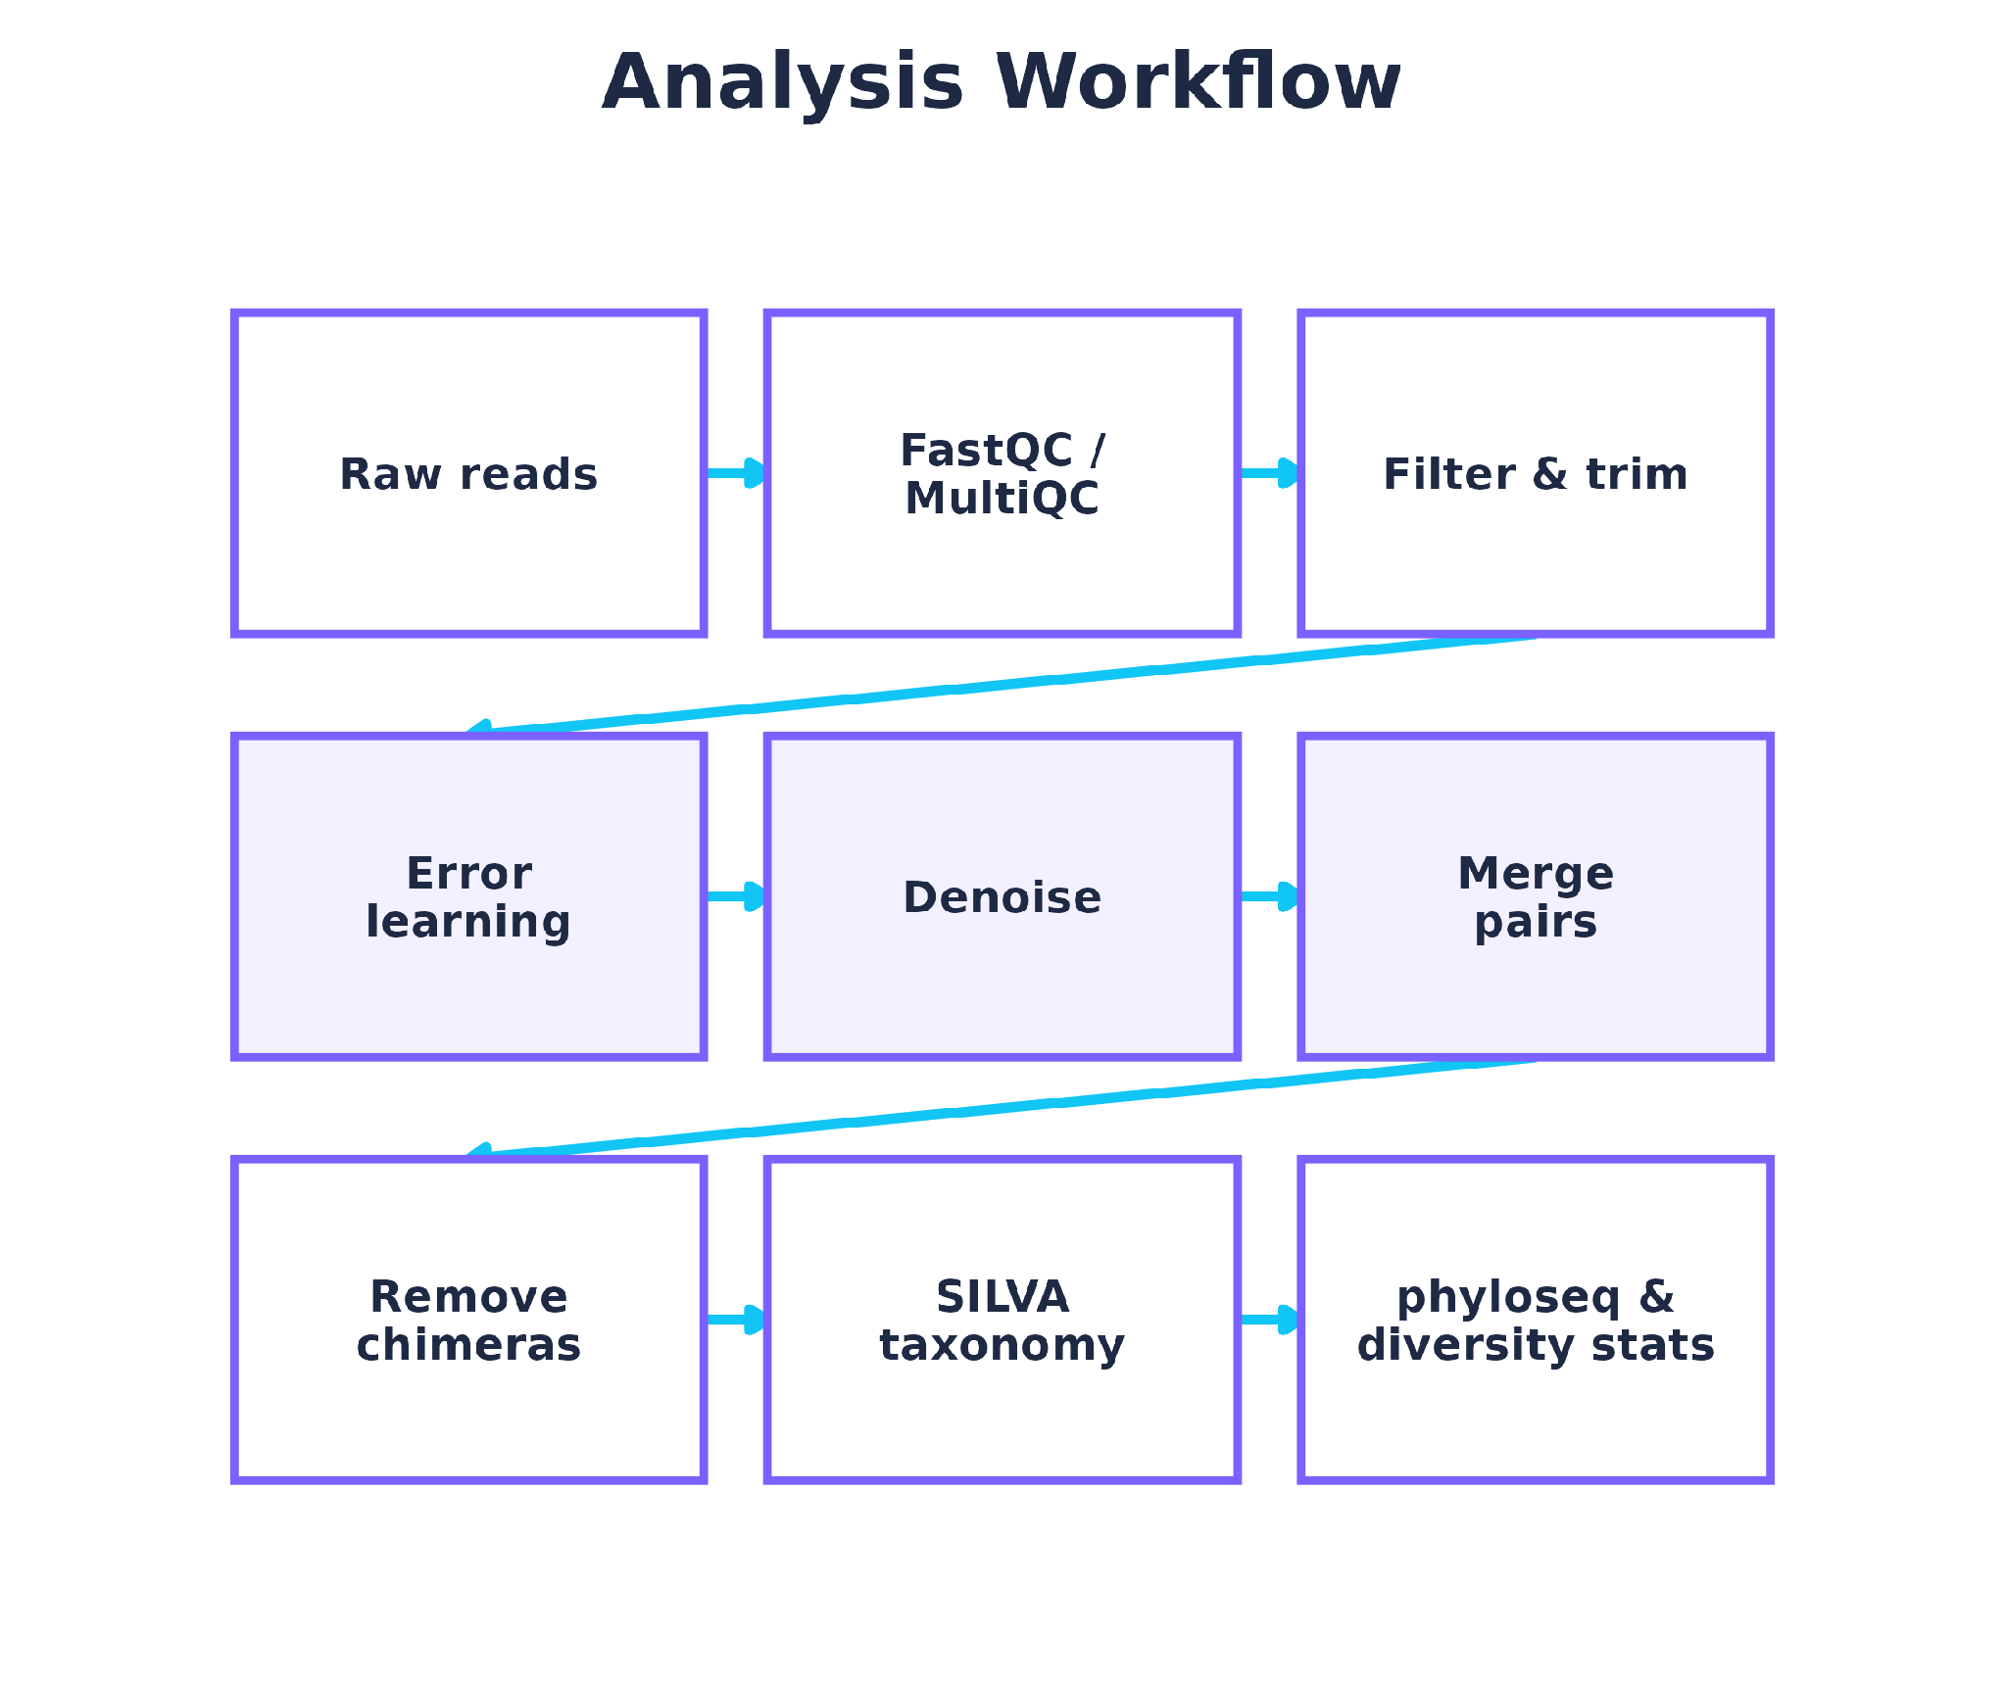
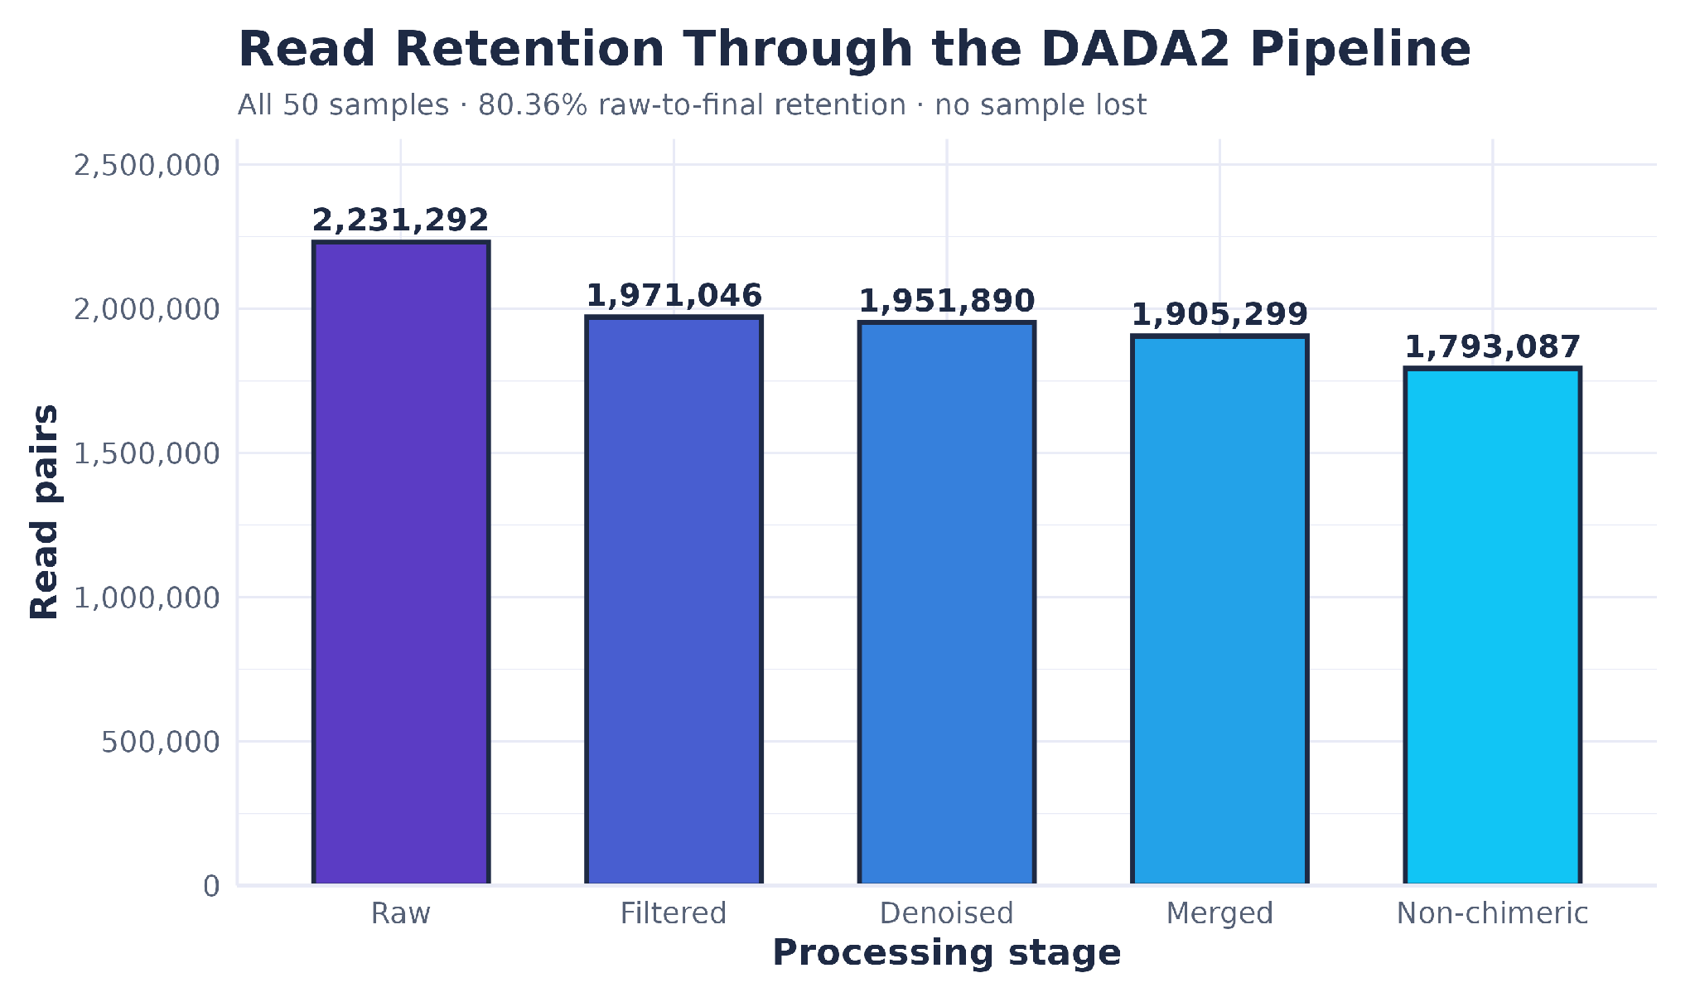
How are IBD status and biopsy location associated with the mucosal bacterial community?
50 paired-end 16S mucosal samples | CD 30 · nonIBD 14 · UC 6 (exploratory) | Ileum 25 · Rectum 25
80.36% of raw read pairs were retained to the non-chimeric sequence table; 1,663 bacterial ASVs remained after taxonomy cleaning.
Almokhtar Aljarodi
Notes:
Total samples: 50
Crohn’s disease, CD: 30
Non inflammatory bowel disease controls, nonIBD: 14
Ulcerative colitis, UC: 6, exploratory
Ileum: 25
Rectum: 25
Raw read pairs: 2,231,292
After filtering: 1,971,046
After denoising: 1,951,890
After merging: 1,905,299
Non chimeric reads: 1,793,087
Retention to non chimeric table: 80.36%
Final bacterial reads after taxonomy cleaning: 1,746,535
Final bacterial ASVs: 1,663
No sample was lost
ASV: Amplicon Sequence Variant, an exact bacterial 16S sequence identified after error correction
SILVA: reference database used to assign bacterial taxonomy
SILVA: classifies each ASV by comparing its 16S sequence with known bacteria. Taxonomy goes from Kingdom → Phylum → Class → Order → Family → Genus. We mainly report genus level.
Important wording: 80.36% refers to raw reads retained to the non chimeric sequence table, not the final taxonomy cleaned dataset

Slide 27
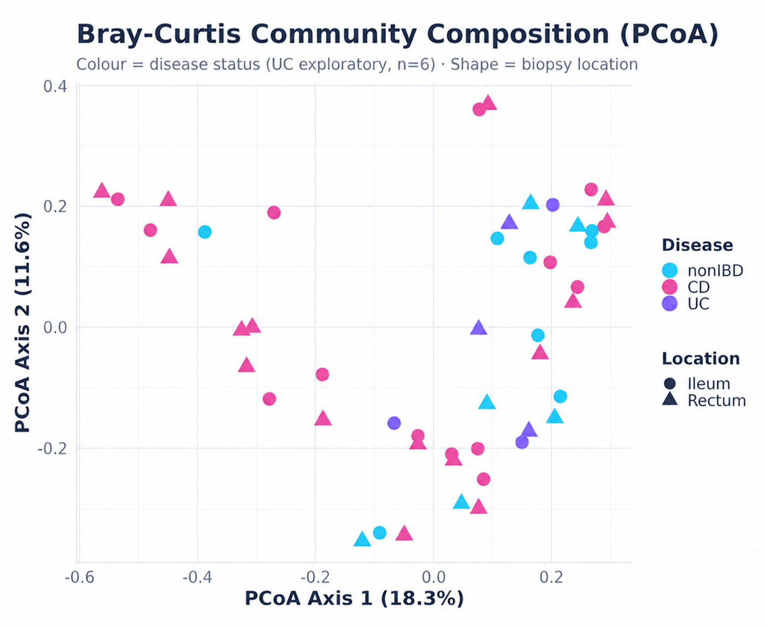
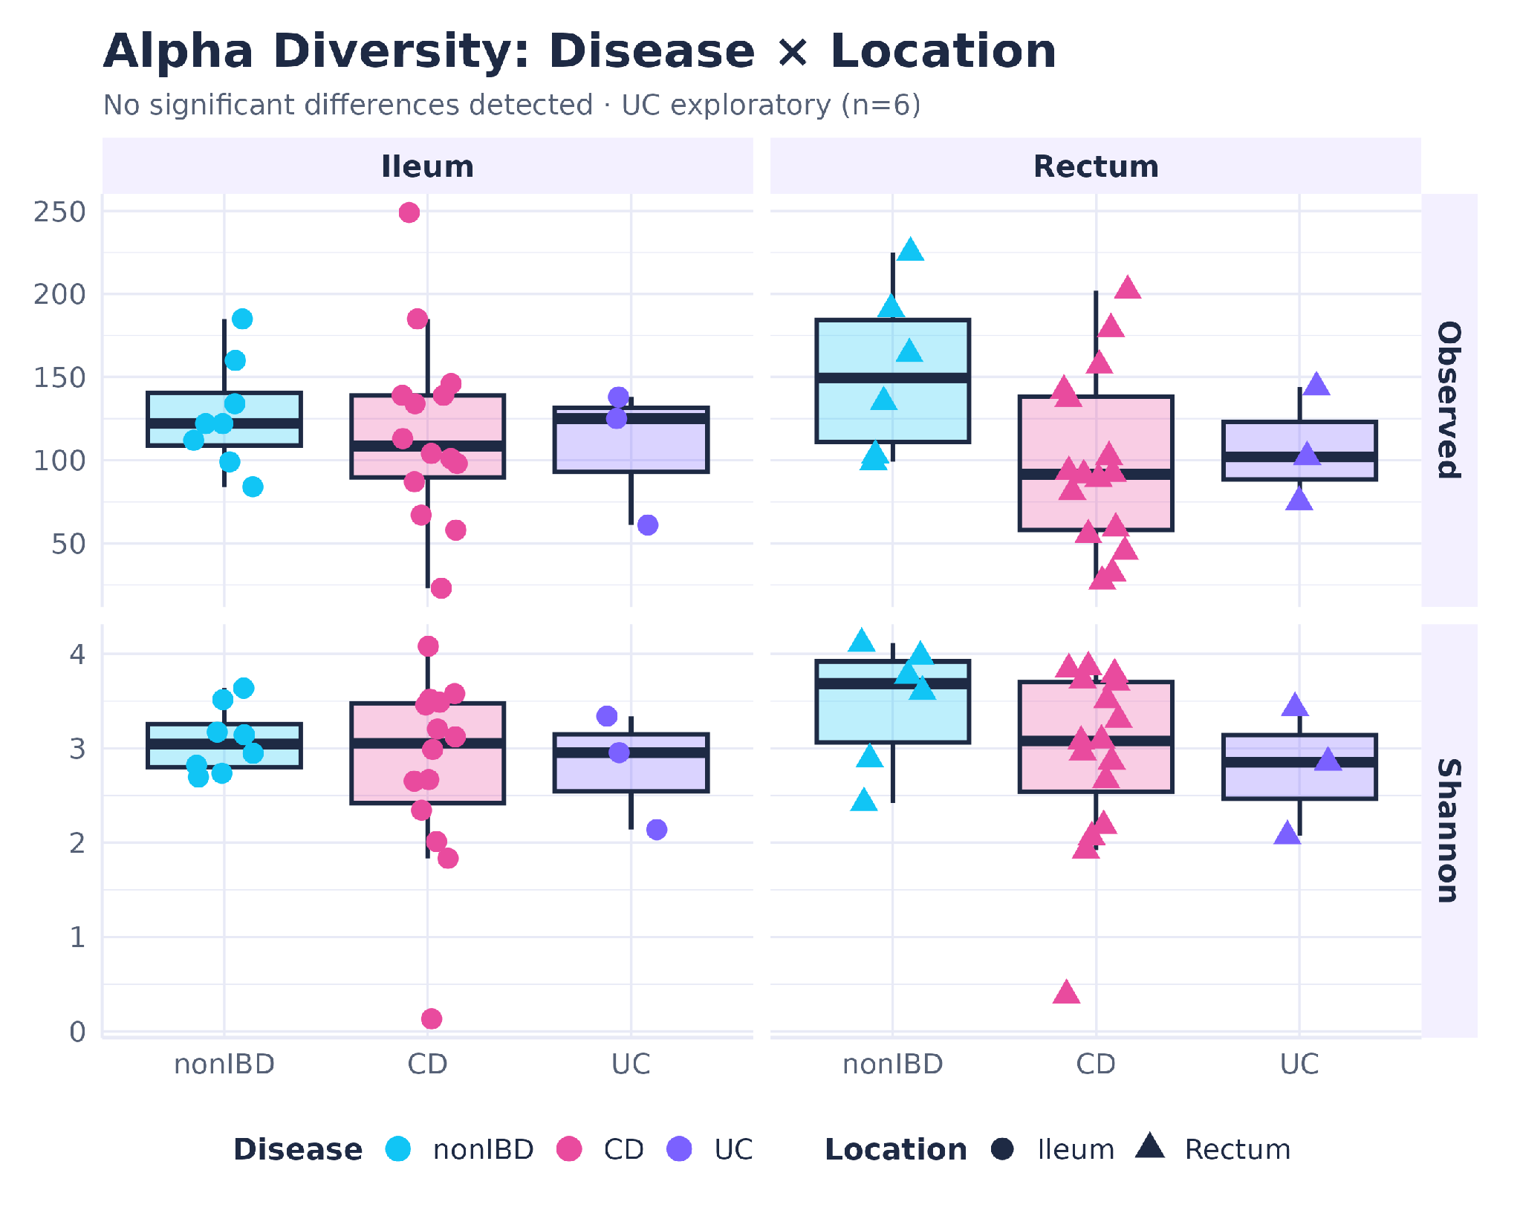

Diversity results and interpretation
Bray-Curtis community structure and within-sample diversity
No significant alpha-diversity or biopsy-location association.
Reference/github
Almokhtar Aljarodi
Notes:
Alpha diversity: diversity within one sample
Observed ASVs: how many bacterial sequence variants are present
Shannon index: how many are present and how evenly distributed they are
Disease alpha diversity
Observed ASVs: p = 0.136
Shannon: p = 0.336
Biopsy location alpha diversity
Observed ASVs: p = 0.580
Shannon: p = 0.335
Crohn’s disease vs nonIBD
Observed ASVs: p = 0.051
Shannon: p = 0.277
Bray Curtis: measures how different two samples are in overall bacterial composition
PCoA: turns those differences into a visual map
Close points: more similar bacterial communities
Far points: more different bacterial communities
Colour: disease status
Shape: biopsy location
PCoA Axis 1: 18.3%
PCoA Axis 2: 11.6%
Together: 29.9% of total variation shown in the two dimensional plot
UC is exploratory because n = 6
Conclusion line
In this dataset, we did not detect significant differences in within sample bacterial diversity or a clear biopsy location association, and the overall bacterial communities showed substantial overlap between groups.

Slide 28
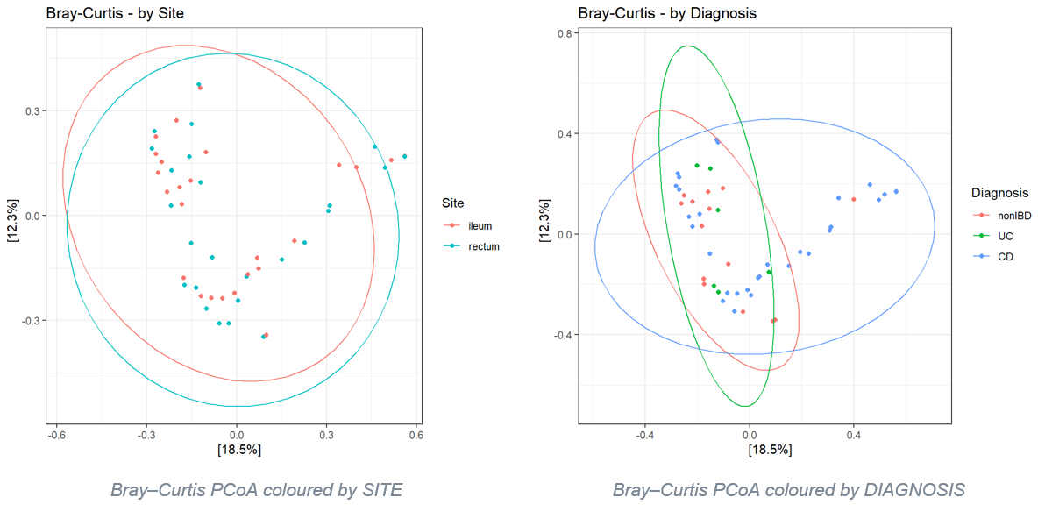
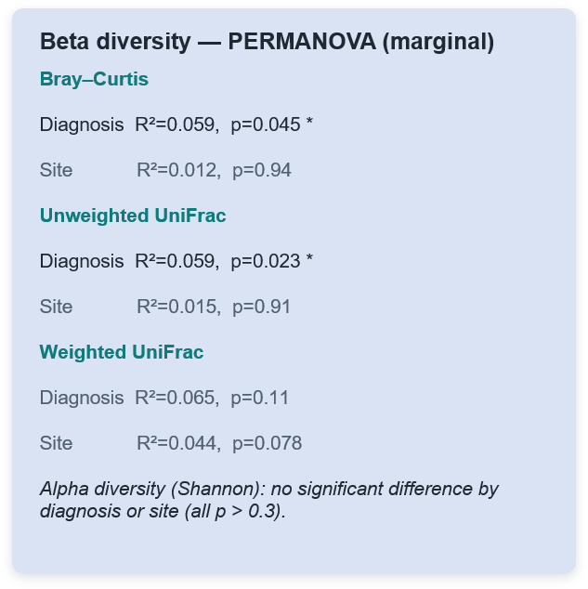
Objective 1 — Anatomy vs. Pathology
Notes:
0. Opening (≈30 sec)
"Hello everyone. Today I'll walk you through a 16S rRNA analysis of the gut mucosal microbiome in inflammatory bowel disease. The goal was to ask a fairly simple question with a not-so-simple answer: when we look at the bacteria living on the gut lining, does the community depend more on where in the gut we sampled, or on whether the person has disease? I'll take you from the study design, through the analysis pipeline, to what we actually found."
1. Research question & objectives (≈45 sec)
"The dataset comes from the IBDMDB — the Inflammatory Bowel Disease Multi-omics Database, part of the second Human Microbiome Project. It contains mucosal biopsy samples from three groups — Crohn's disease, ulcerative colitis, and non-IBD controls — taken from two anatomical sites, the terminal ileum and the rectum.
We had three core objectives:
First, anatomical versus pathological stratification — do communities cluster by tissue site or by disease state? This is the headline question.
Second, dysbiosis profiling — can we see the classic inflammation signature, where beneficial obligate anaerobes like Faecalibacterium are lost and facultative anaerobes like Enterobacteriaceae expand?
Third, differential abundance — which specific taxa distinguish ileal Crohn's from rectal ulcerative colitis?"
2. Experimental design (≈45 sec)
"The design is a two-factor layout: three diagnoses crossed with two sites. We had 50 curated samples — 30 Crohn's, 14 controls, and 6 ulcerative colitis. Sites were evenly balanced, 25 ileum and 25 rectum.
I'll flag one thing early because it shapes how we should read the results: ulcerative colitis is thin — only three samples per site. So while the design looks clean, UC is underpowered, and I'll come back to what that means.
On the sequencing side: this is the 16S V4 region, amplified with the standard 515F–806R primers, sequenced on an Illumina MiSeq with 250-base paired-end reads."
3. Analysis pipeline (≈70 sec)
"For the bioinformatics, I used the DADA2 workflow into phyloseq.
Reads were quality-filtered and trimmed, then DADA2's error model denoised them into exact amplicon sequence variants — ASVs — rather than clustering into fuzzy OTUs. Forward and reverse reads were merged, and chimeras removed; only about 6% of reads were chimeric, which is normal. That left roughly 1,900 ASVs across the 50 samples.
Taxonomy was assigned against SILVA. Non-bacterial and unassigned ASVs were a negligible fraction (one archaeal ASV and 18 without a phylum out of ~1,880) and were left in; they're low-abundance and don't affect the community-level results."
From there the analysis split three ways to match the objectives: alpha and beta diversity for the anatomy-versus-disease question; targeted tracking of the two dysbiosis marker groups; and DESeq2 differential abundance for the biomarker question. For the differential-abundance step I used size factors designed to handle the many zeros in microbiome data, and I ran contrasts within each site as well, so I could separate a disease effect from an anatomy effect."
4. Finding 1 — Anatomy vs. Pathology (≈70 sec)
"[Slide 1]
Start with diversity. Alpha diversity — the richness and evenness within a sample — showed no significant difference at all, whether we split by diagnosis or by site. All p-values were above 0.3. So overall diversity is preserved; that's not where disease leaves its mark.
The signal is in beta diversity — differences in community composition between samples. These two ordination plots show the same samples coloured two ways: on the left by site, on the right by diagnosis. And this is the key result: when we test it formally with PERMANOVA, diagnosis is the only factor that reaches significance — for Bray–Curtis, p equals 0.045, and for unweighted UniFrac, p equals 0.023. Anatomical site is never significant — its p-values sit near 0.9.
So the answer to our headline question is: these communities separate by disease state, not by anatomical site.
I want to be honest about the size of that effect, though. Diagnosis explains only about 6% of the variation — an R-squared around 0.06. So it's a real but modest separation. Site simply doesn't drive it."

Slide 29
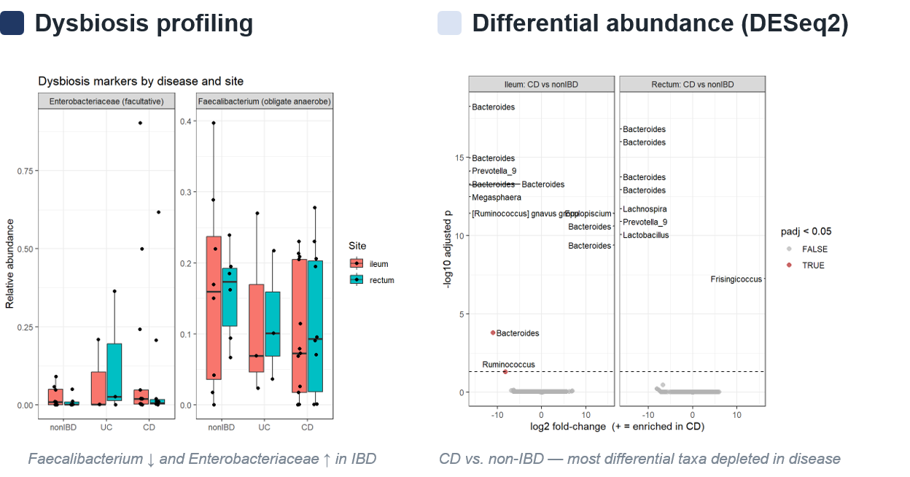
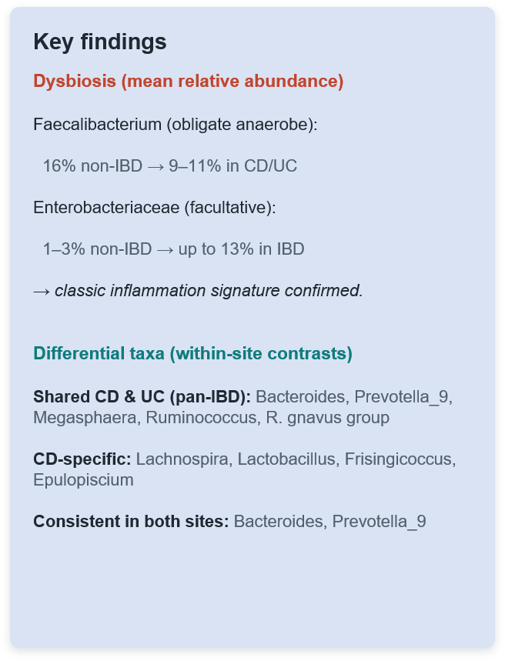
Objectives 2 & 3 — Dysbiosis & Differential Abundance
Notes:
5. Finding 2 — Dysbiosis (≈50 sec)
"[Slide 2 — left]
Second objective: the dysbiosis signature. And here the textbook pattern shows up cleanly.
Faecalibacterium — an obligate anaerobe, one of the beneficial butyrate producers — drops from about 16% relative abundance in controls to roughly 9 to 11% in disease.
At the same time, Enterobacteriaceae — facultative anaerobes that bloom in an inflamed, oxygen-disturbed gut — expand from around 1 to 3% in controls up to about 13% in IBD.
That's exactly the direction the literature predicts: loss of beneficial anaerobes, expansion of inflammation-associated facultative organisms. So the classic dysbiosis signature is confirmed in this dataset."
6. Finding 3 — Differential abundance (≈60 sec)
"[Slide 2 — right]
Third, the differential-abundance analysis. The consistent theme across every contrast is that the significant taxa are almost all depleted in disease — again, loss of commensals rather than the arrival of new organisms.
When I compared the disease signatures across sites, some taxa came up as pan-IBD — shifted in both Crohn's and ulcerative colitis — including Bacteroides, Prevotella, Megasphaera, and Ruminococcus. A smaller set was Crohn's-specific, such as Lachnospira, Lactobacillus, and Frisingicoccus. And two genera — Bacteroides and Prevotella — were significant in both the ileum and the rectum, which makes them the most defensible disease markers, because they track the disease regardless of where we sampled.
Now the caveat, and it's an important one. Because ulcerative colitis only had three samples per site, a lot of the raw hits show enormous fold-changes — and those come from a taxon being simply absent in a tiny group, not from a real quantitative shift. So I treat those large-effect UC results as exploratory — hypothesis-generating, not conclusions."
7. Limitations (≈30 sec)
"To be upfront about the limits: the ulcerative colitis group is small, so anything UC-specific is tentative. A handful of rectal Crohn's samples were sequenced quite shallowly, which can artificially deflate the taxa detected — so a sensible next step is a minimum-depth filter and re-running the contrasts. And the overall effect sizes are modest, which is honest for 50 mucosal samples."
8. Conclusion (≈30 sec)
"To wrap up. In this mucosal dataset, disease state — not anatomical site — is what shapes the microbial community, though the effect is modest. We recovered the classic dysbiosis signature: Faecalibacterium down, Enterobacteriaceae up. And our differential-abundance analysis pointed to a set of consistently depleted commensals, with Bacteroides and Prevotella as the sturdiest, site-independent disease markers.
So the overall message is that inflammation reshapes which bacteria are present more than how many kinds there are — and it does so consistently enough that we can see it even in a small, mixed cohort. Thank you — happy to take questions."

Slide 30
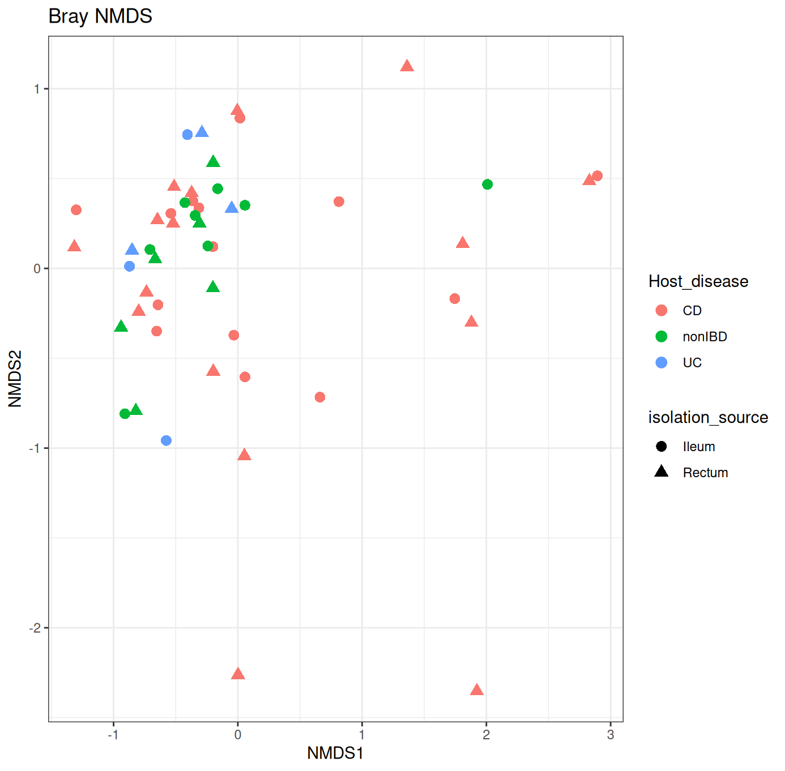
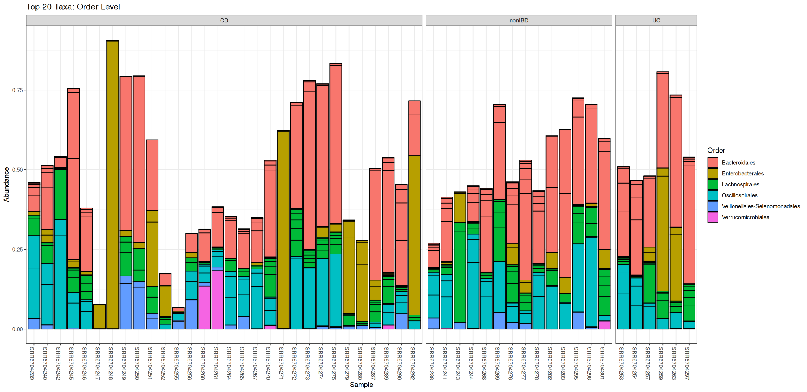
Technical Pipeline & Overall Community Composition
Ahmed Mawlawi
[ Phase 1: QC & Filtering ] > [ Phase 2: Denoising & Assembly ] >[ Phase 3: Taxonomy & Integration ]
Notes:
What Was Done (Analysis):
Processed raw 16S fastq reads through DADA2 (truncLen = c(225, 160), truncQ = 2, maxEE = c(2, 2), rm.phix = TRUE), assigned taxonomy using the SILVA database, and built a phyloseq object.
Generated Bray-Curtis NMDS and relative abundance stacked bar plots across taxonomic levels to observe overall community shifts.
Results & Conclusions:
Pipeline & Beta Diversity (NMDS): Quality filtering successfully generated high-resolution ASVs. NMDS shows nonIBD (green) and UC (blue) tightly clustered, whereas CD (red) is wildly scattered—proving Crohn's pathology overrules anatomical location.
Phylum Level Composition: Shows a massive pink Proteobacteria expansion in CD, indicating a shift toward inflammatory facultative anaerobes.
Class Level Composition: Healthy controls are dominated by Clostridia (olive) and Bacteroidia (salmon). CD displays a severe Gammaproteobacteria (bright green) bloom.
Order Level Composition: Healthy gut is rich in obligate anaerobes (Lachnospirales & Oscillospirales). CD shows an explosion of Enterobacterales (gold) and significant depletion of obligate anaerobes.

Slide 31
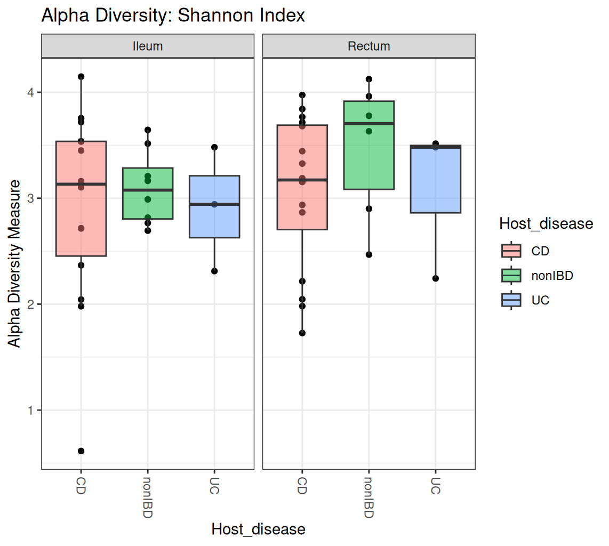
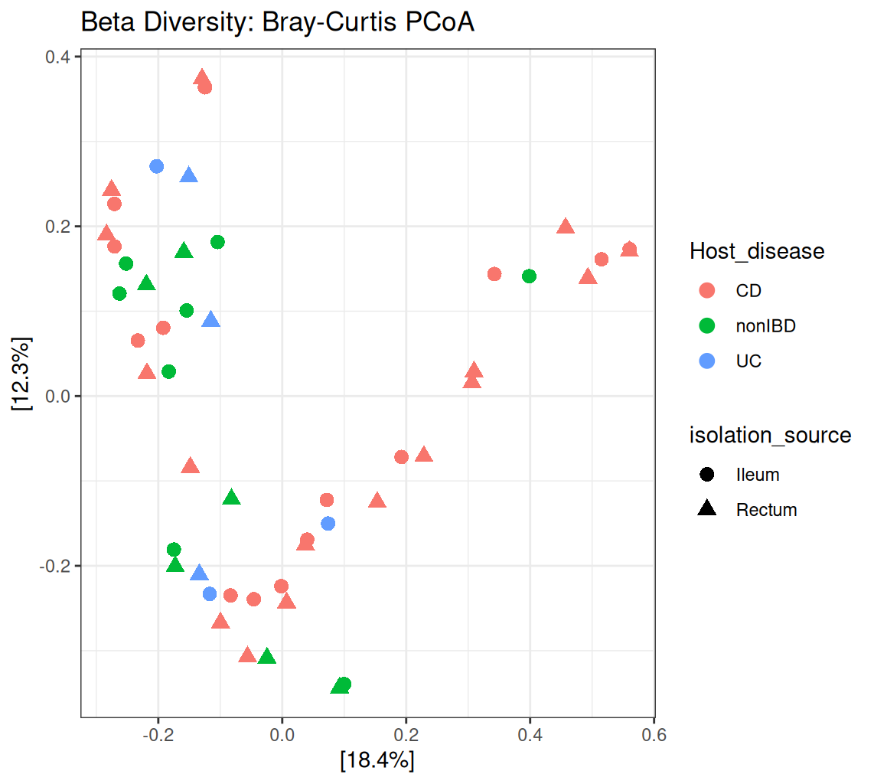
Anatomical vs. Pathological Diversity
Ahmed Mawlawi
Notes:
Slide Title:
Is mucosal microbiome variation driven primarily by tissue location or disease state?
Figures Included on Slide:
Alpha Diversity Boxplot (Shannon Index)
Beta Diversity PCoA Plot (Bray-Curtis)
What Was Done (Analysis):
Calculated Shannon Alpha Diversity across clinical groups and tissue sites, and constructed a Bray-Curtis PCoA to map structural similarities.
Results & Conclusions:
Alpha Diversity (Shannon): Anatomical location dictates diversity in healthy controls (Rectum median ~3.7 > Ileum ~3.1). Disease causes chaos; CD destroys this baseline, causing extreme instability and severe loss of diversity (crashing below 1.0).
Beta Diversity (PCoA): Captures 30.7% variance (18.4% Axis 1, 12.3% Axis 2). NonIBD and UC cluster together in a healthy baseline, while CD scatters broadly across both axes.
The Conclusion: The severe inflammation of Crohn's Disease is the dominant force. It completely overpowers the natural anatomical signatures, driving the microbiome into a state of chaotic dysbiosis.

Slide 32
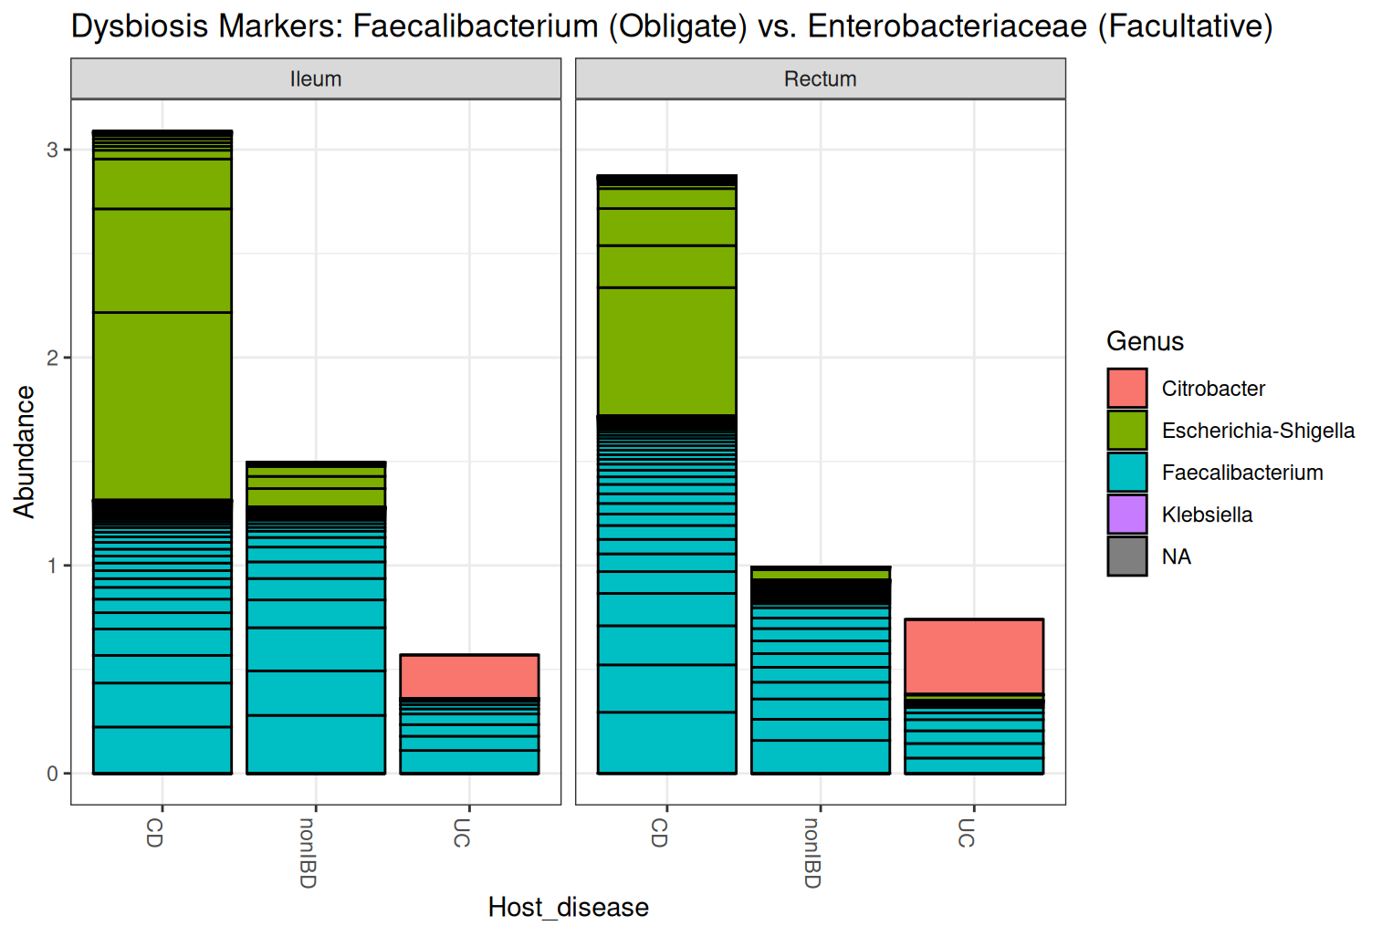

Dysbiosis Profiling & Biomarker Discovery
Ahmed Mawlawi
Notes:
Slide Title:
What characterizes targeted IBD dysbiosis, and which specific bacterial genera act as the strongest statistical biomarkers?
Figures Included on Slide:
Targeted Dysbiosis Markers (Faecalibacterium vs. Enterobacteriaceae)
Discovered Biomarkers Plot (Prevotella_9 vs. Epulopiscium)
What Was Done (Analysis):
Isolated specific classic IBD markers requested by the clinical prompt, then Aggregated taxa to the Genus level (tax_glom), normalized sparse data (poscounts), and ran DESeq2 differential abundance testing (log2FoldChange, adjusted p-value $< 0.05$) comparing CD against nonIBD controls.
Results & Conclusions:
Targeted Dysbiosis: The healthy baseline relies on cyan Faecalibacterium (healthy obligate anaerobe). During Crohn's inflammation, green Escherichia-Shigella (harmful facultative anaerobes) completely explodes, while the healthy obligate anaerobes shrink drastically (especially notable in UC).
Statistical Discovery: DESeq2 proved Epulopiscium is the top mathematically expanded genus (highest positive fold-change) and Prevotella_9 is the top depleted genus (most negative fold-change).
Depletion/Expansion Mechanics: As a strict obligate anaerobe, Prevotella_9 drops to 0% relative abundance in the CD Ileum because aggressive inflammation floods the tissue with toxic oxygen. The expansion of Epulopiscium illustrates the complexity of real-world dysbiosis, where Expansion Mechanics (Epulopiscium): Biologically a strict obligate anaerobe; its mathematical expansion illustrates real-world dysbiosis complexity (opportunistic blooms driven by nutrient shifts or loss of competition) operating alongside standard facultative blooms.. Epulopiscium Log2FC = 23.88571
Prevotella_9 Log2FC = -7.945466

Slide 33
58% of 10.6 M reads survive to 12,902 ASVs
Aim: what reshapes an oil-well microbiome — the supplement, or time?
Denoise & merge
Remove chimeras
Assign taxonomy
Raw reads
Filter & trim
ENA PRJNA894184
74 samples
148 FASTQ files
250 bp paired-end
filterAndTrim
trimLeft 19 / 20
truncLen 240 / 220
maxEE 2,2 · truncQ 2
dada + mergePairs
learned error model
overlap ≥ 12 bp
seen: 48–51 bp
removeBimeraDenovo
consensus method
102,467 chimeric
ASVs (Amplicon Sequence Variants) removed
assignTaxonomy
SILVA v138.1
minBoot = 50
10,607,522
reads
9,485,615
reads (89.4%)
8,873,208
reads (83.6%)
6,181,969
reads (58.3%)
12,902
ASVs kept
16S rRNA amplicon (515f–926r) · 74 microcosms from oil Well D · 4 supplements × 6 days × 3 replicates
Thikra · Hillman et al. (2022), AIChE Journal, 68(12), e17927. https://doi.org/10.1002/aic.17927

Slide 34

Treated communities diverge, then reconverge
The treatment effect is a detour, not a destination.
Thikra · Hillman et al. (2022), AIChE Journal, 68(12), e17927. https://doi.org/10.1002/aic.17927

Slide 35

Incubation day explains 56%; supplement 15%
56%
incubation day
15%
mineral supplement
21%
day × supplement
Share of total community variation. All three p = 0.001.
Time matters ~4× more than the supplement.
Separate PERMANOVA within each day · n = 12 · all days p ≤ 0.016
Thikra · Hillman et al. (2022), AIChE Journal, 68(12), e17927. https://doi.org/10.1002/aic.17927

Slide 36

Every supplement erases Desulfovibrio
Supplements erase the souring organism; time drives the community.
1.41%
no supplement, day 14
0%
molybdate — undetected at days 5 and 14
Thikra · Hillman et al. (2022), AIChE Journal, 68(12), e17927. https://doi.org/10.1002/aic.17927

Slide 37


Does microbiome clustering depend on disease or location?
FASTQ 50 samples
›
QC 210/130 bp
›
DADA2
›
MERGE 96.75%
›
CLEAN 971 ASVs
›
TAXONOMY SILVA 138.1
What did I do? Compared community composition (PCoA + PERMANOVA) and Shannon diversity after rarefaction.
What did we find? Location: p=0.982.
Disease: p=0.057
not significant
Haitham Alahmadi

Slide 38

Are there any signs of dysbiosis?
What did I do?
Calculated Faecalibacterium relative abundance and compared groups with Kruskal–Wallis.
What did I find?
Faecalibacterium: p=0.459
Haitham Alahmadi

Slide 39


Which taxa differ between disease groups?
What did we do? DESeq2. DESeq2 on sparse microbiome counts required the 'poscounts' size-factor method to run.
Result CD vs nonIBD → 10 strongly significant taxa (padj 4.84e-15 to 5.07e-10). Citrobacter freundii ↑; Bacteroides vulgatus & Akkermansia ↓.
Haitham Alahmadi

